Slide 1
The Special Olympics powerpoint template
Some tips on creating your own template and great presentations.

Slide 2
First get the typeface…
This presentation uses the typeface Ubuntu.
This typeface can be downloaded for free from http://font.ubuntu.com/
Install the typeface as required by your particular computer. Ubuntu is compatible with PC and Mac and is optimized for on screen applications.

Slide 3
Create your own template
To create Program template please open the Slide Master page (View > Master > Slide Master) and replace ‘Program Name’ text with the name of your program.
In the footer insert the name of your program after the works ‘Special Olympics’.
Save file as PPT template and use as basis for future presentations. (you may want to delete these pages first.
You can also save this Template as the default theme on your computer.

Slide 4
A few tips…

Slide 5
Standard text slide
For most simple text slides we should use a clean slide such as this.
This keeps the presentation feeling fresh and simple – clear communication.
The typeface is Ubuntu – Special Olympics’ identity typeface and available free from
http://font.ubuntu.com/

Slide 6
Themes!
Don’t forget that there are different slide layouts available within Powerpoint for chapter-heads, image slides etc.
The next slide uses the Picture with Caption format option from the Special Olympics theme.
Avoid putting too many points on the one slide.

Slide 7
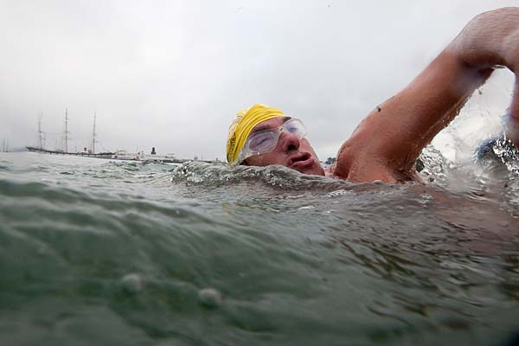
A picture paints a thousand words
Use the Picture and Caption format to create strong compelling slide like this. Don’t’t forget to caption where possible. For best effect crop the image to fill the placeholder.

Slide 8
Use chapter slides to punctuate the presentation

Slide 9
Tip.
Use large text to make a point.
(Same slide template and just increase the text size)

Slide 10
Your slides should be:
SIMPLE
CLEAN
STRONG

Slide 11
Aim to reflect our personality:
Inspirational
Joyful
Inclusive
Determined
Courageous
Authentic

Slide 12
Thank you. (Now don’t forget to follow the instructions on slides 2 & 3.)

