Slide 1
New Athlete Registration Requirements

Slide 2
Agenda
What’s new
Why changes have been made
Overview of each form
Support and resources available
Roll-out timeline
Support through the transition

Slide 3
What’s New?
Physician signature is no longer required:
The requirements at the Program/State level have been removed.
Applies only to athletes participating in: Regional Games, World Games, Invitational and USA Games or if required by local laws or Program rules.
Health history required:
To help keep everyone safe, we’ll continue asking for a health history form. This needs to be updated every year. This is the minimum requirement to join the movement, but Programs can choose to have different requirements if they wish.
Special Olympics strongly encourages athletes to undertake regular
medical checkups for the benefit of their own health and safety

Slide 4
Why Changes Have Been Made
Registration has been complex and difficult for families.
Simplifying changes make signing up easier for everyone.
The need for a physical exam was serving as a barrier and had low compliance.

Slide 5
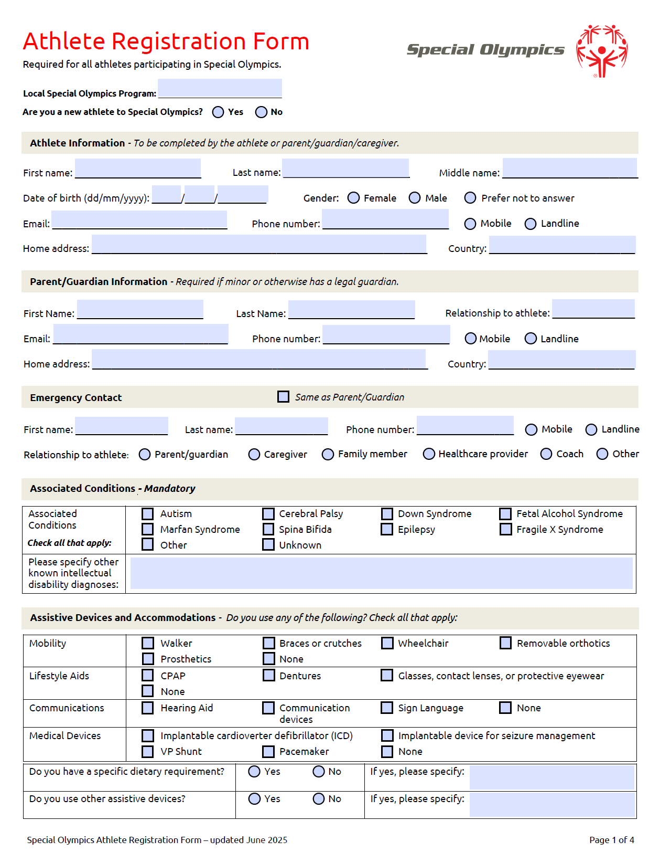
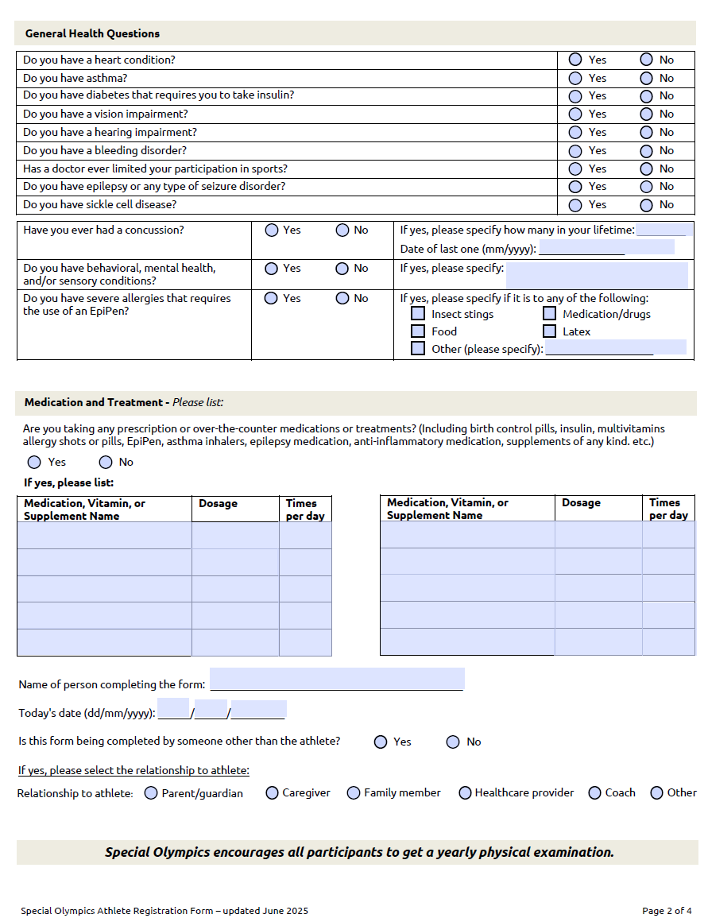

Overview of Athlete Registration
Athlete Information
General Health Questions
Parent/Guardian Information
Emergency Contact
Medication and Treatment
Associated Conditions
Assistive Devices and Accommodations
Completed by athlete when they join Special Olympics.

Slide 6
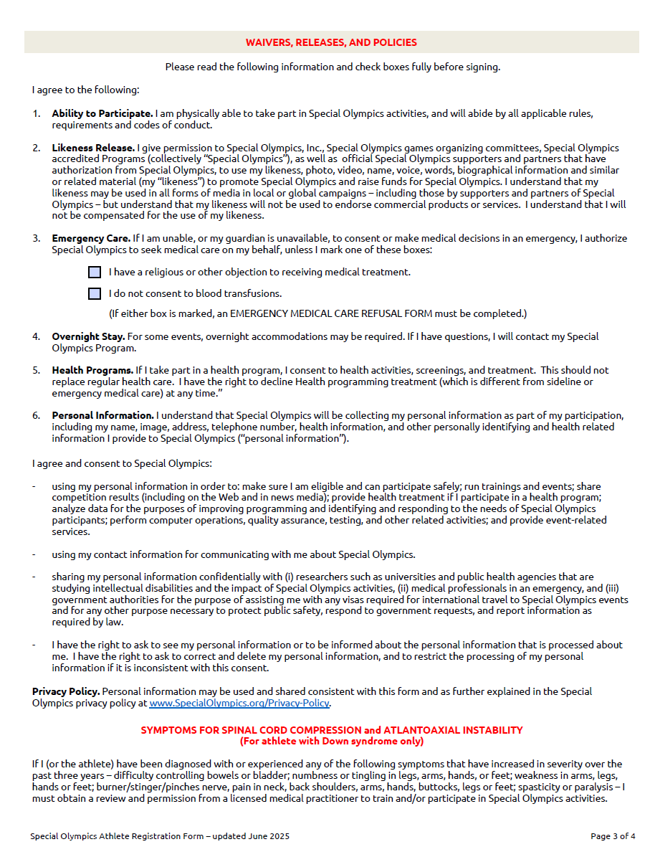
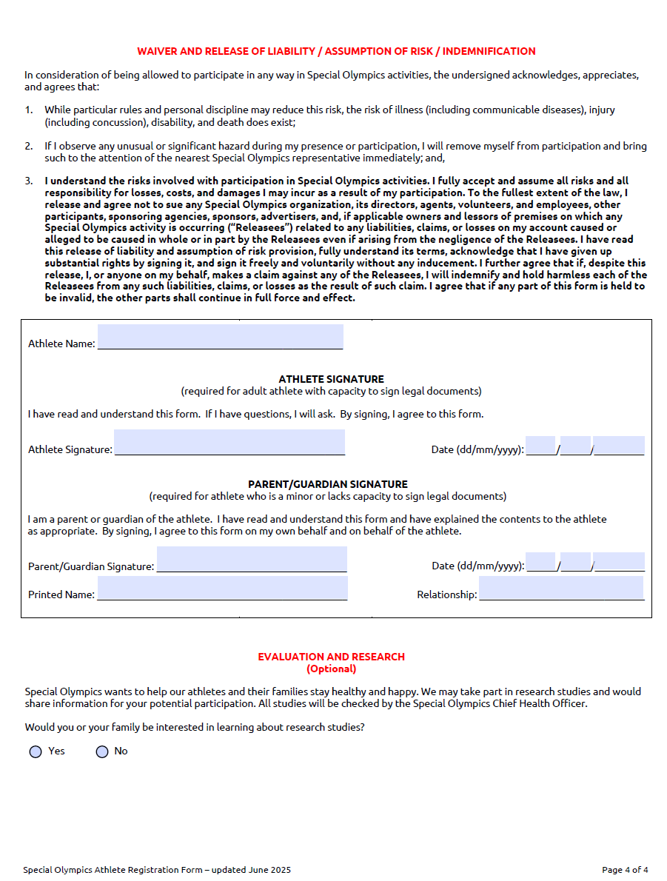
Overview of Athlete Registration Form (2)
Rules that explain what the athlete agrees to.
Emergency Care
Evaluation and Research
Completed by athlete when they join Special Olympics.

Slide 7
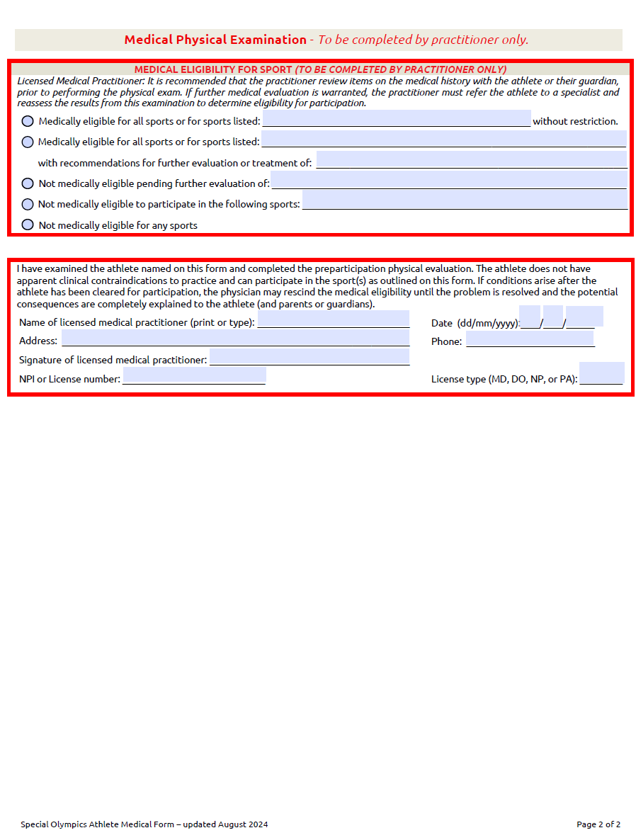
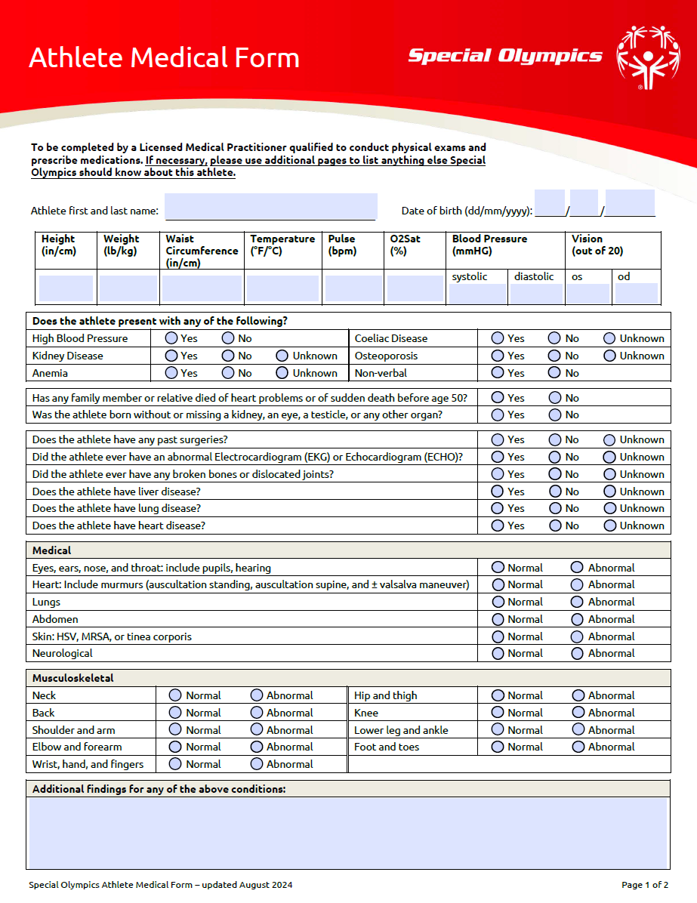
Overview of Athlete Medical Form
Approval from a doctor that it’s safe to take part.
Athlete Information
Doctor sign off
Health Details
Information about muscles, bones, and joints.
Only required for Regional Games, World Games, Invitational and USA Games.

Slide 8
Positives of New Forms
✅ Easier access – no doctor visits or signatures required.
✅ Simplified, easy-read forms improve understanding.
✅ Annual updates keep information current.
✅ Coaches training available to enhance use of information.
✅ Tutorials to guide families through form completion.
✅ Digitalization streamlines access and reduces paperwork.

Slide 9
Challenges with Updated Forms
⚠️ It may take some time for Programs to start using the new forms.
⚠️ Relies on families and athletes sharing accurate information.
⚠️ Digital access and data privacy must be managed.
⚠️ Tutorials may be skipped or misunderstood.

Slide 10
Managing General Health Questions
A two-level flag system to help with reviewing
Level 1 flag – Needs to be checked by a doctor
Criteria: "Yes"
If someone answers “Yes” to having a concussion within the past month, or if a doctor has recommended limiting their participation unless proof of past medical clearance can be provided, they must be flagged for follow-up.
Action:
A doctor or licensed medical professional must check the athlete and confirm they are healthy enough to take part in Special Olympics sports.

Slide 11
Managing General Health Questions
Two-tiered flag system for reviewing
Level 2
Criteria: "Yes"
If someone answers “yes” to any of the following health conditions: Heart condition, Asthma, Diabetes requiring insulin, Epilepsy/Seizure disorder, Sickle Cell, Bleeding disorder, Allergy requiring an EpiPen, Behavioral health or Sensory disorder, Vision or hearing impairment.
The coach should talk with the athlete and their family or caregiver, create an up-to-date action plan, and make sure all coaches working with the athlete know about the plan and how to find it.
Action:

Slide 12
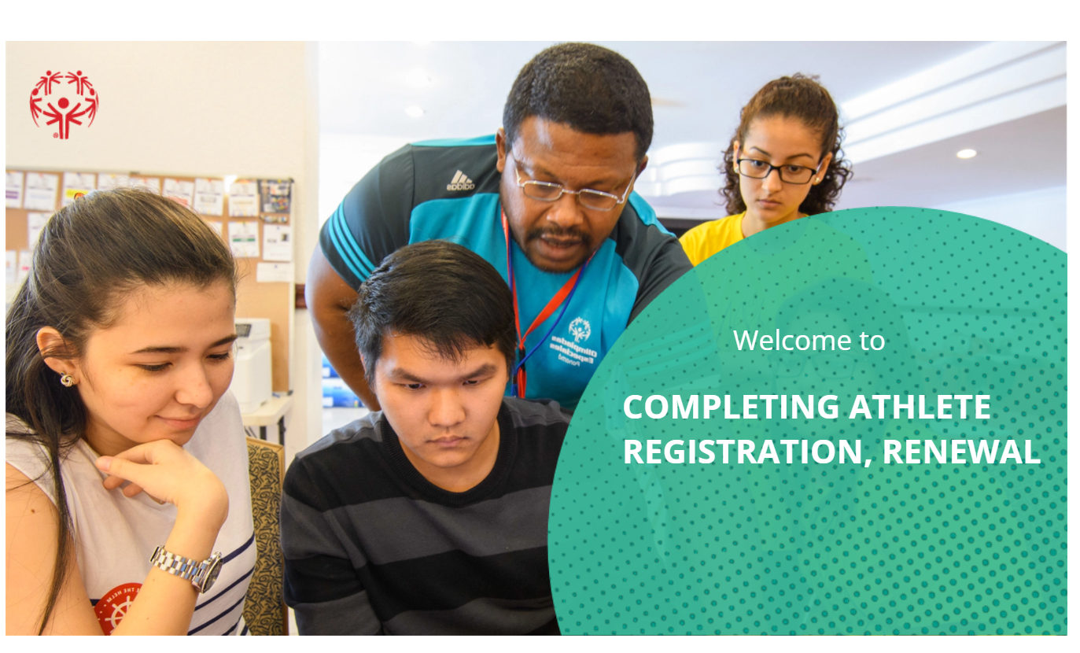
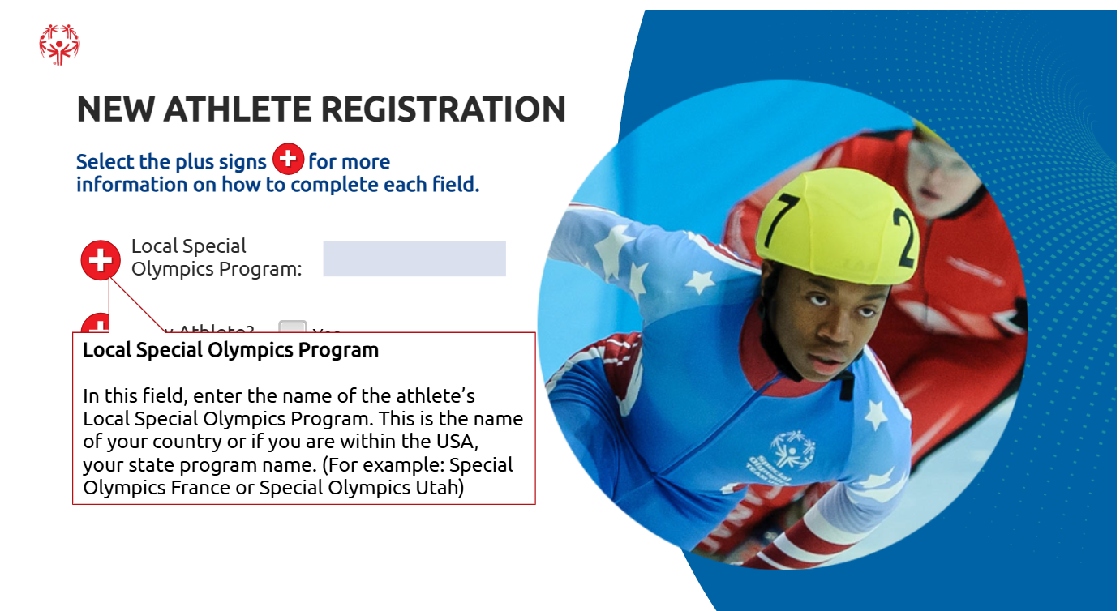
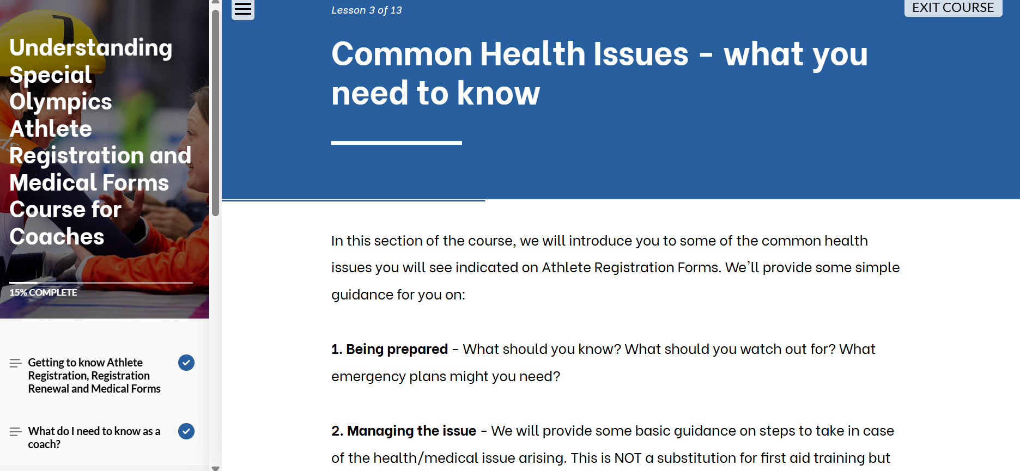
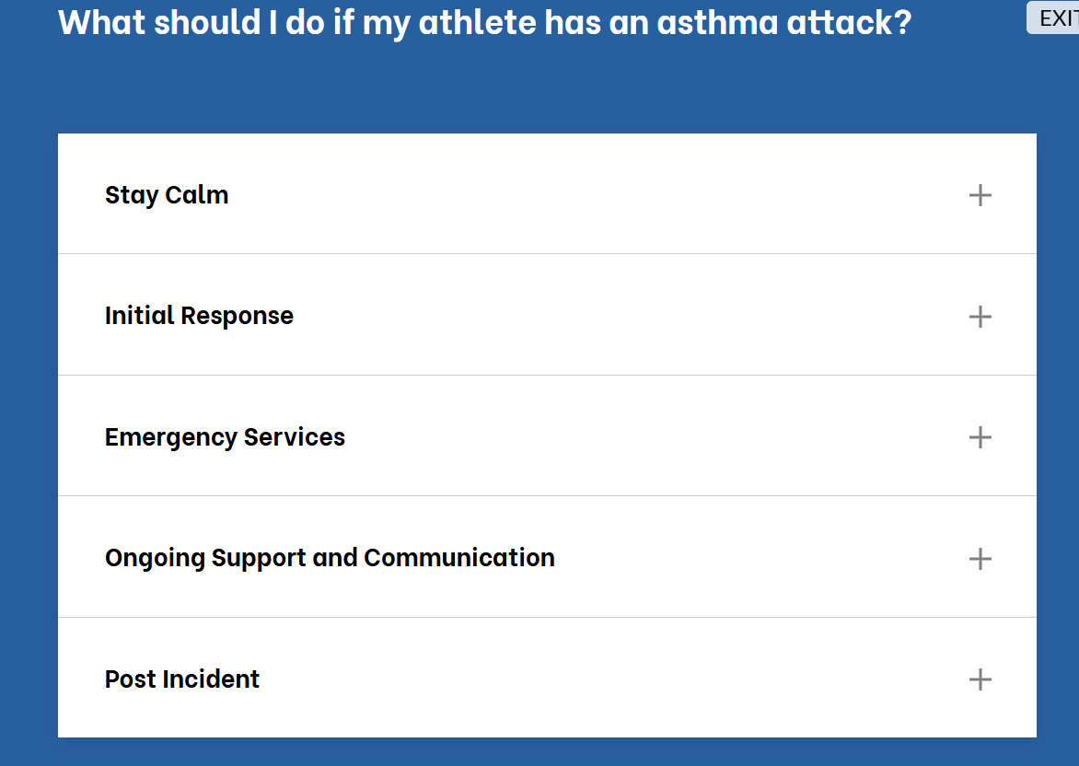
Support & Resources
Suite of tools :
How to complete the forms training,
Guidance for coaches and volunteers on how to use the information captured on the forms,

Slide 13
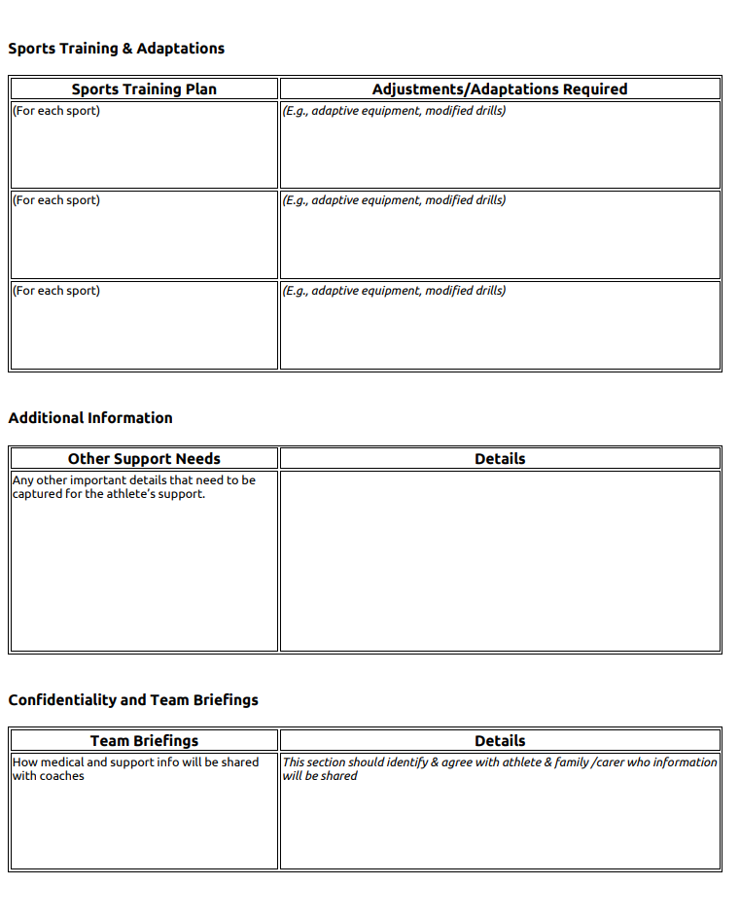
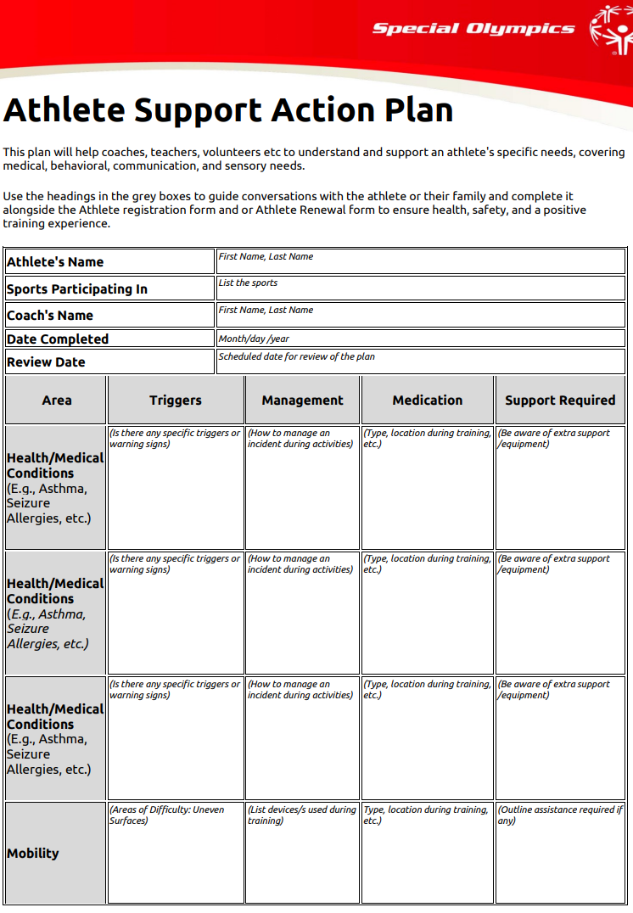
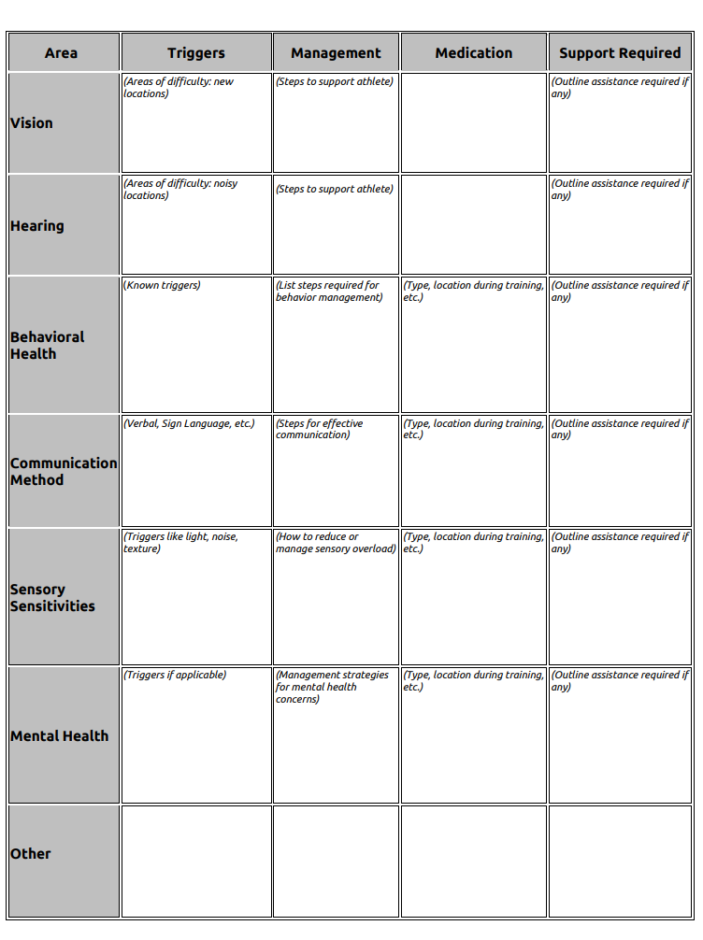
Athlete Support Action Plan link to plan here

Slide 14
Summary
New Athlete Registration Forms
Medical Forms used only World Games/SOI-led events.
These simplified forms replace the older, more complex versions.
Resources are available for completing the forms.

Slide 15

Questions

