Slide 1
Special Olympics Wisconsin
Local Programs

Slide 2
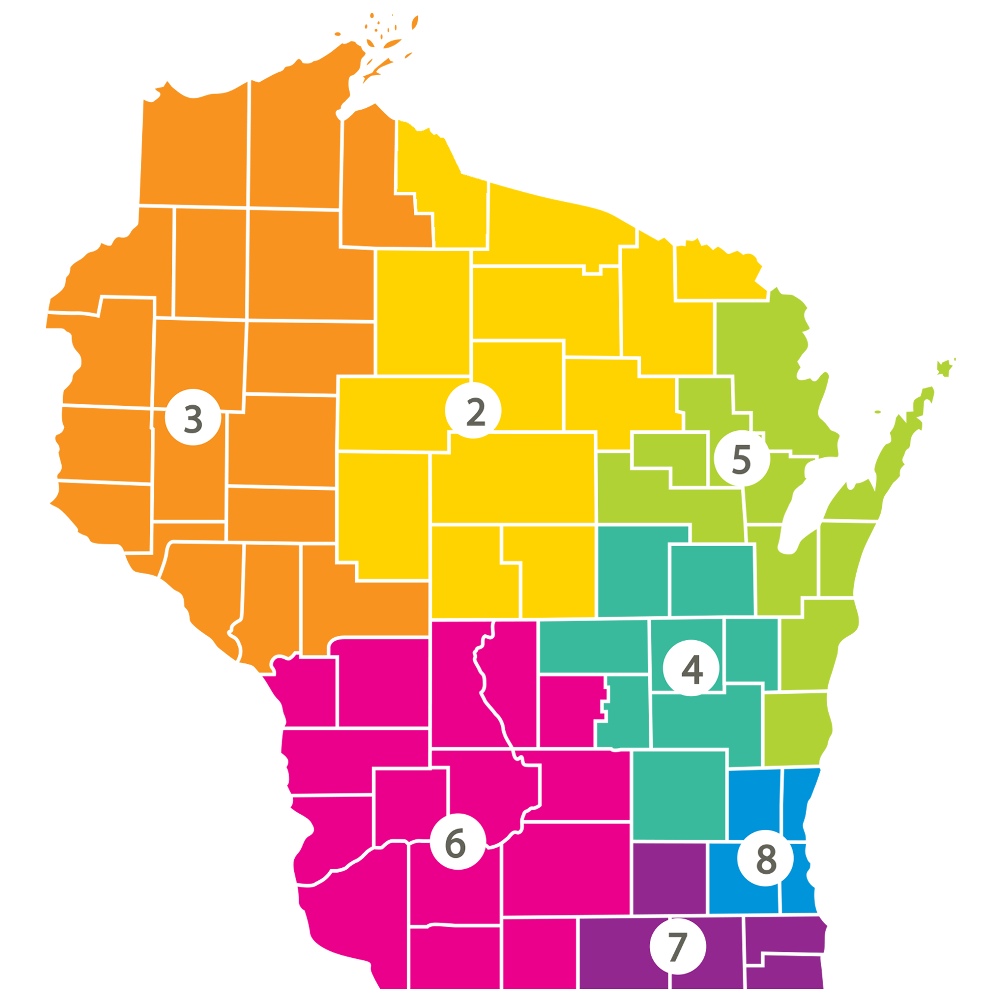
Statewide Impact
125
Local Programs
2,481
Class A
Volunteers
522
Class A Certified
Coaches
TOTAL ATHLETES BY REGIONS:
R2: 595 │ R3: 691 │ R4: 705 │ R5: 711 │ R6: 1070 │ R7: 977 │ R8: 1,551
Notes:
Chad

Slide 3
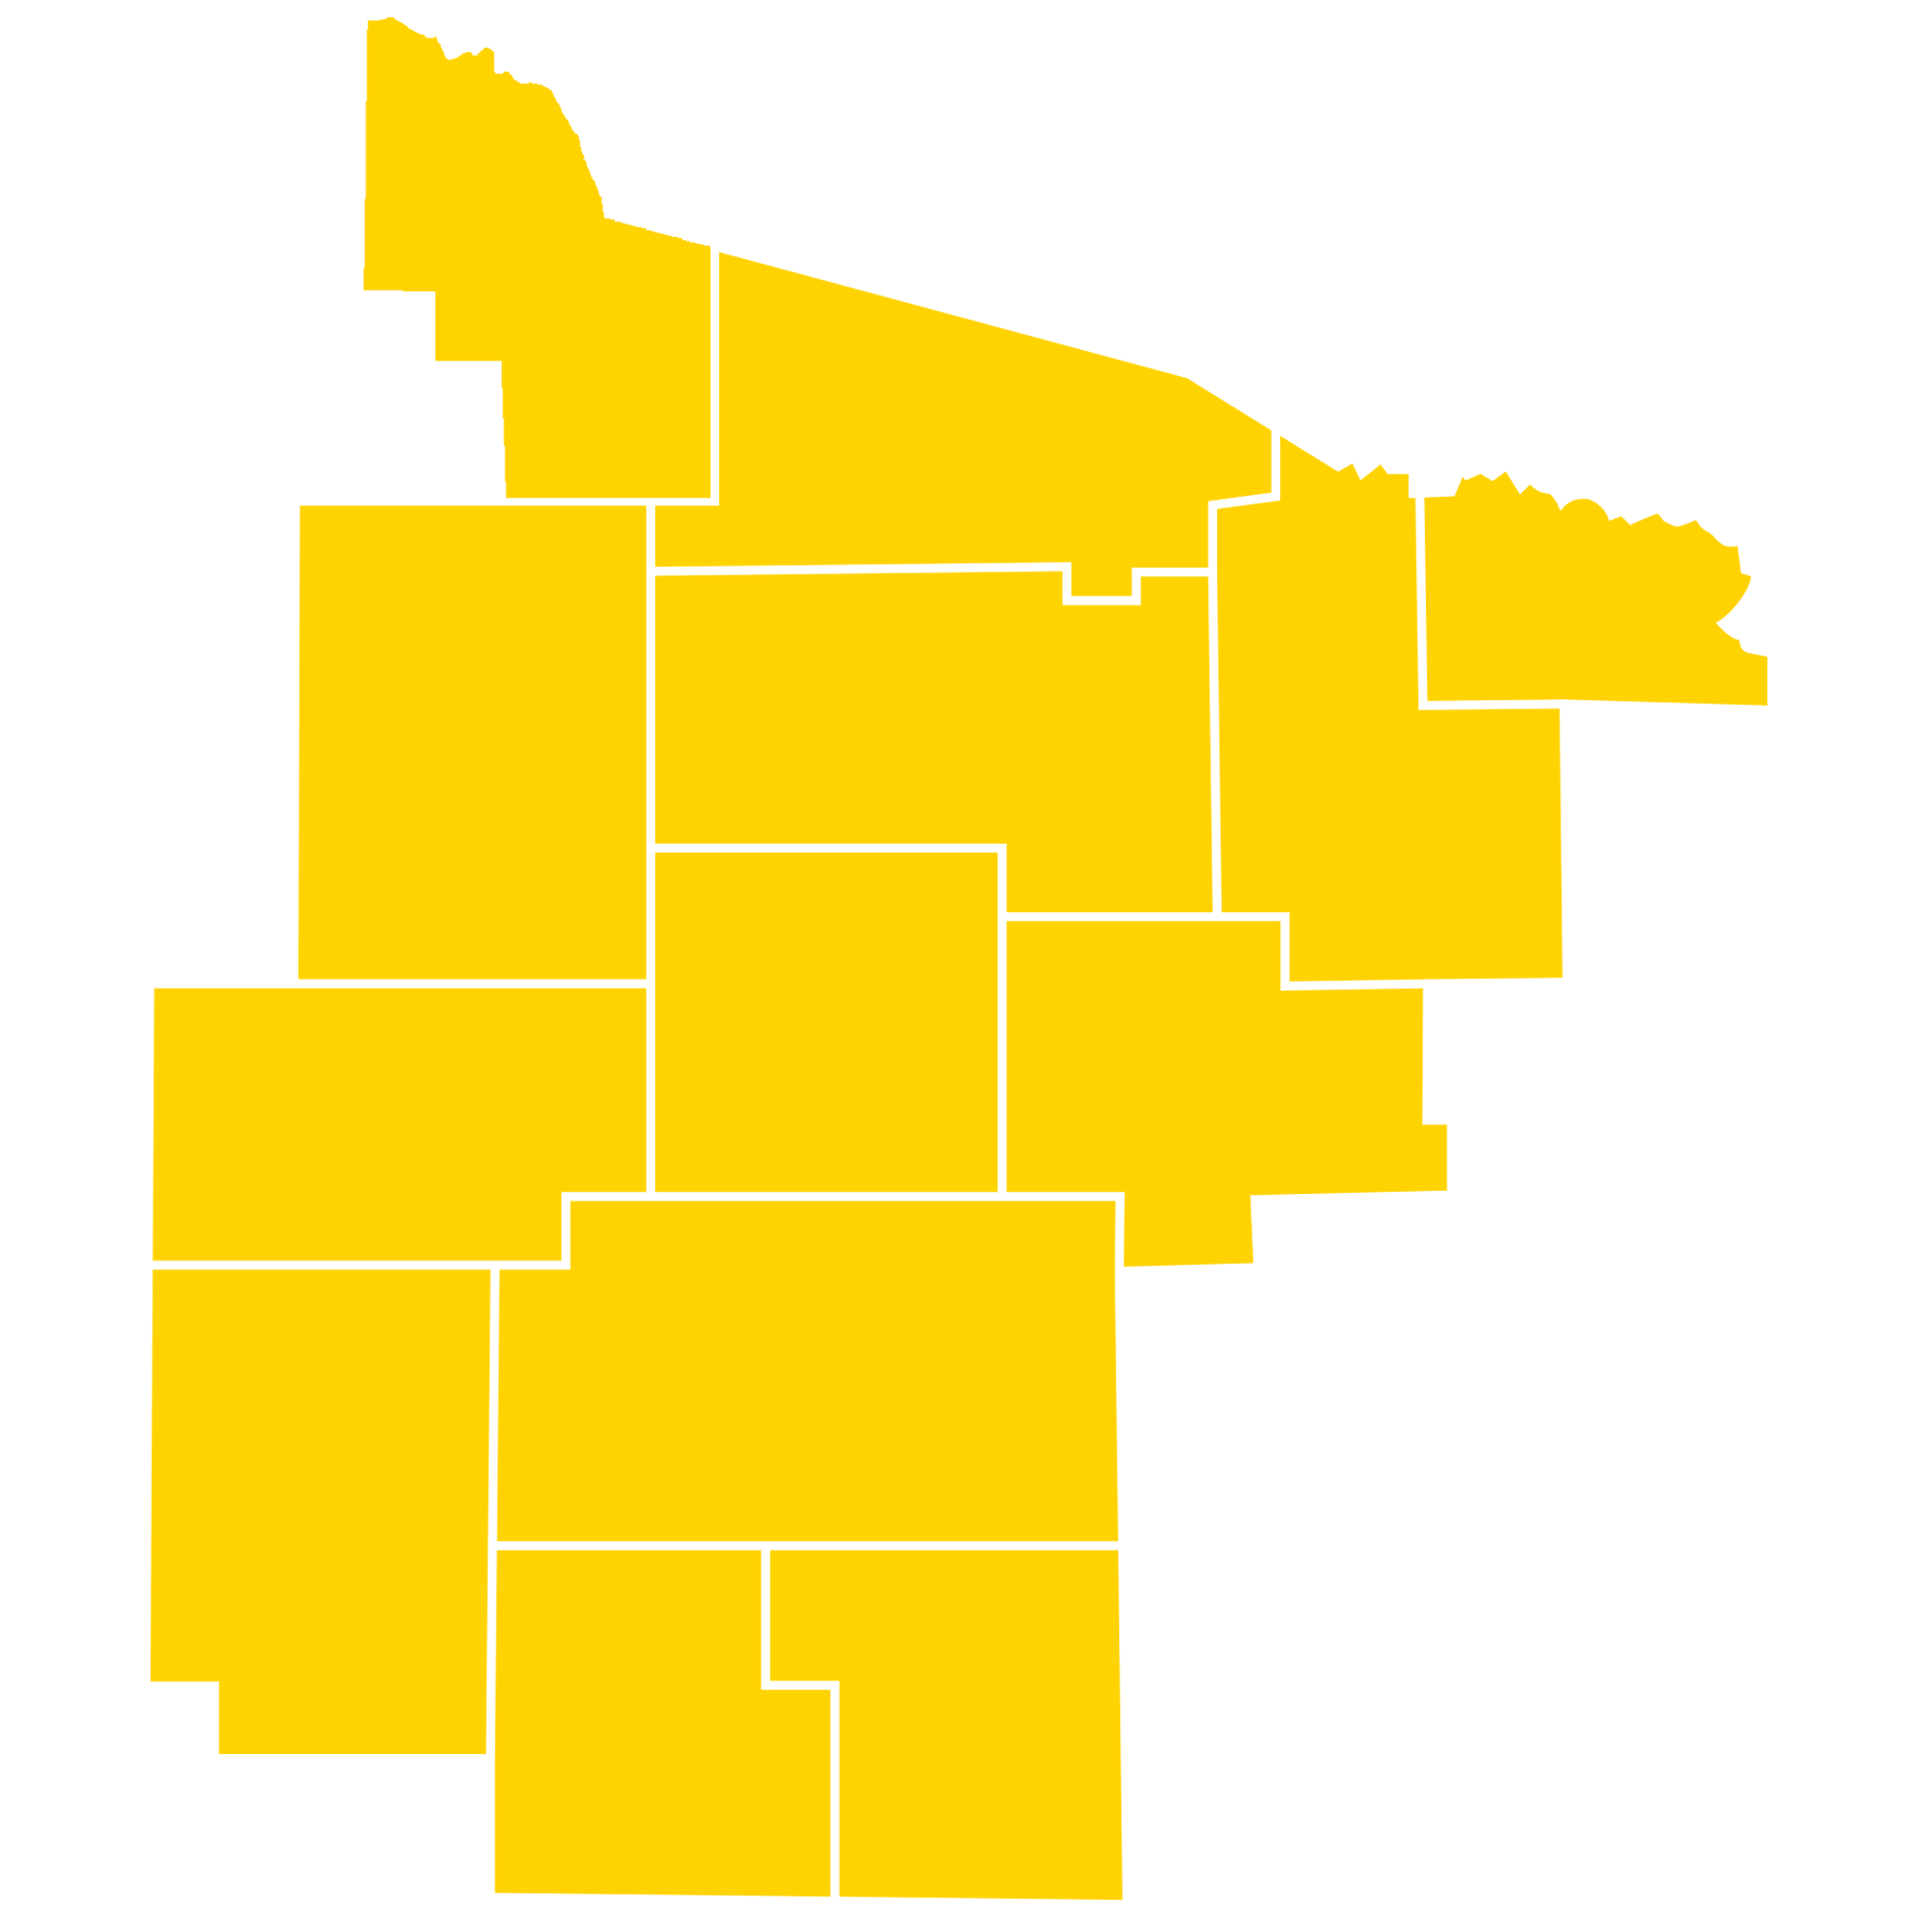
LOCAL PROGRAM MANAGERS - Region 2
2-01 Jeanne Long
2-03 Bev Schmidt
2-05 SueEllen Hopp
2-09 John Janikowski
2-11 Lou Deditz & Mary Mulleady
2-12 Neillsville Dean Glaze,
2-13 John Christensen & Sally Siems
2-14 Tina Chevalier-Laube
2-17 Randy Follen & Janet Bell
2-20 Linda Bartelt
2-21 Emily Heckendorf
2-25 Kristy Bridenhagen
2-28 Cheryl Johnson-Domino
2-29 Nina Hazelton
2-30 Rhonda Baldwin
2-39 Kathleen Derks
2-43 Lisa Brill
2-44 Jacqueline Kleman

Slide 4
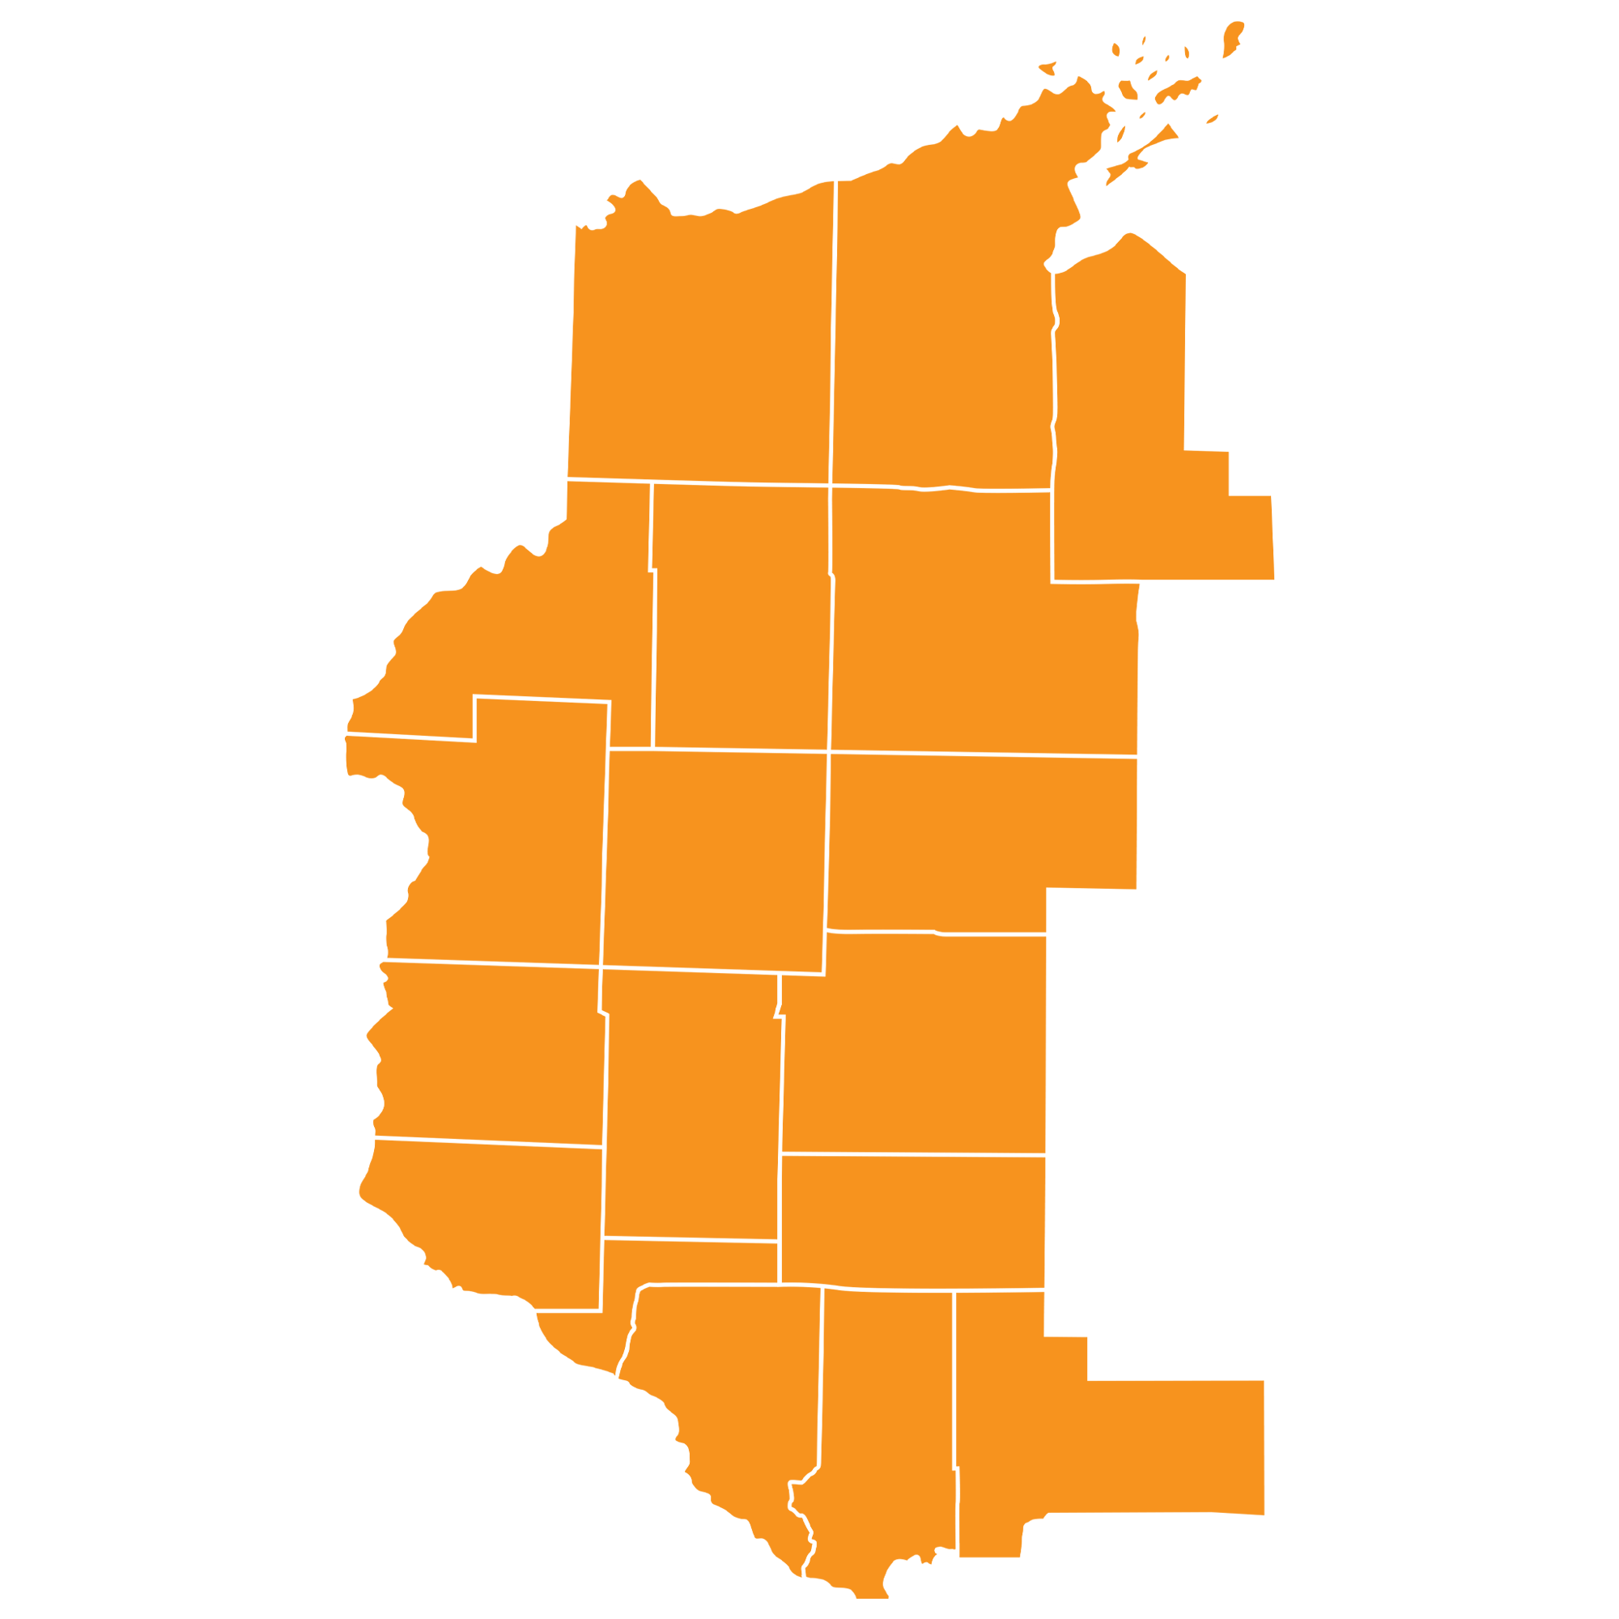
LOCAL PROGRAM MANAGERS – Region 3
3-06 Kimberly Huber & Richard Gavitt
3-09 Denise Roesler
3-10 Denise Buckli
3-12 Michelle Fulweber
3-15 Kimberly Bond
3-18 Diana Lightner
3-21 Kathryn Spence
3-25 Dan Gainey
3-30 Mary Ebner
3-31 Carolee Lundsten & Mary Paske
3-33 Justin Jablonske
3-36 Leanne Richter
3-56 Brandy Pecha
3-57 McKenzie Bauer

Slide 5

LOCAL PROGRAM MANAGERS - Region 4
4-02 Mary Beth Connors & Susan Bralich
4-04 Tracy Gabel
4-06 Chad Oeftger
4-08 Tobis Trochinski
4-12 Jordan Wood
4-14 Brian Shaver
4-15 William Lannyk
4-18 Jennifer Wilz
4-19 Kelly Hass
4-20 Daniel Mallmann
4-25 Jennifer Kalishek
4-29 Chad Oeftger & Sally Jepson

Slide 6
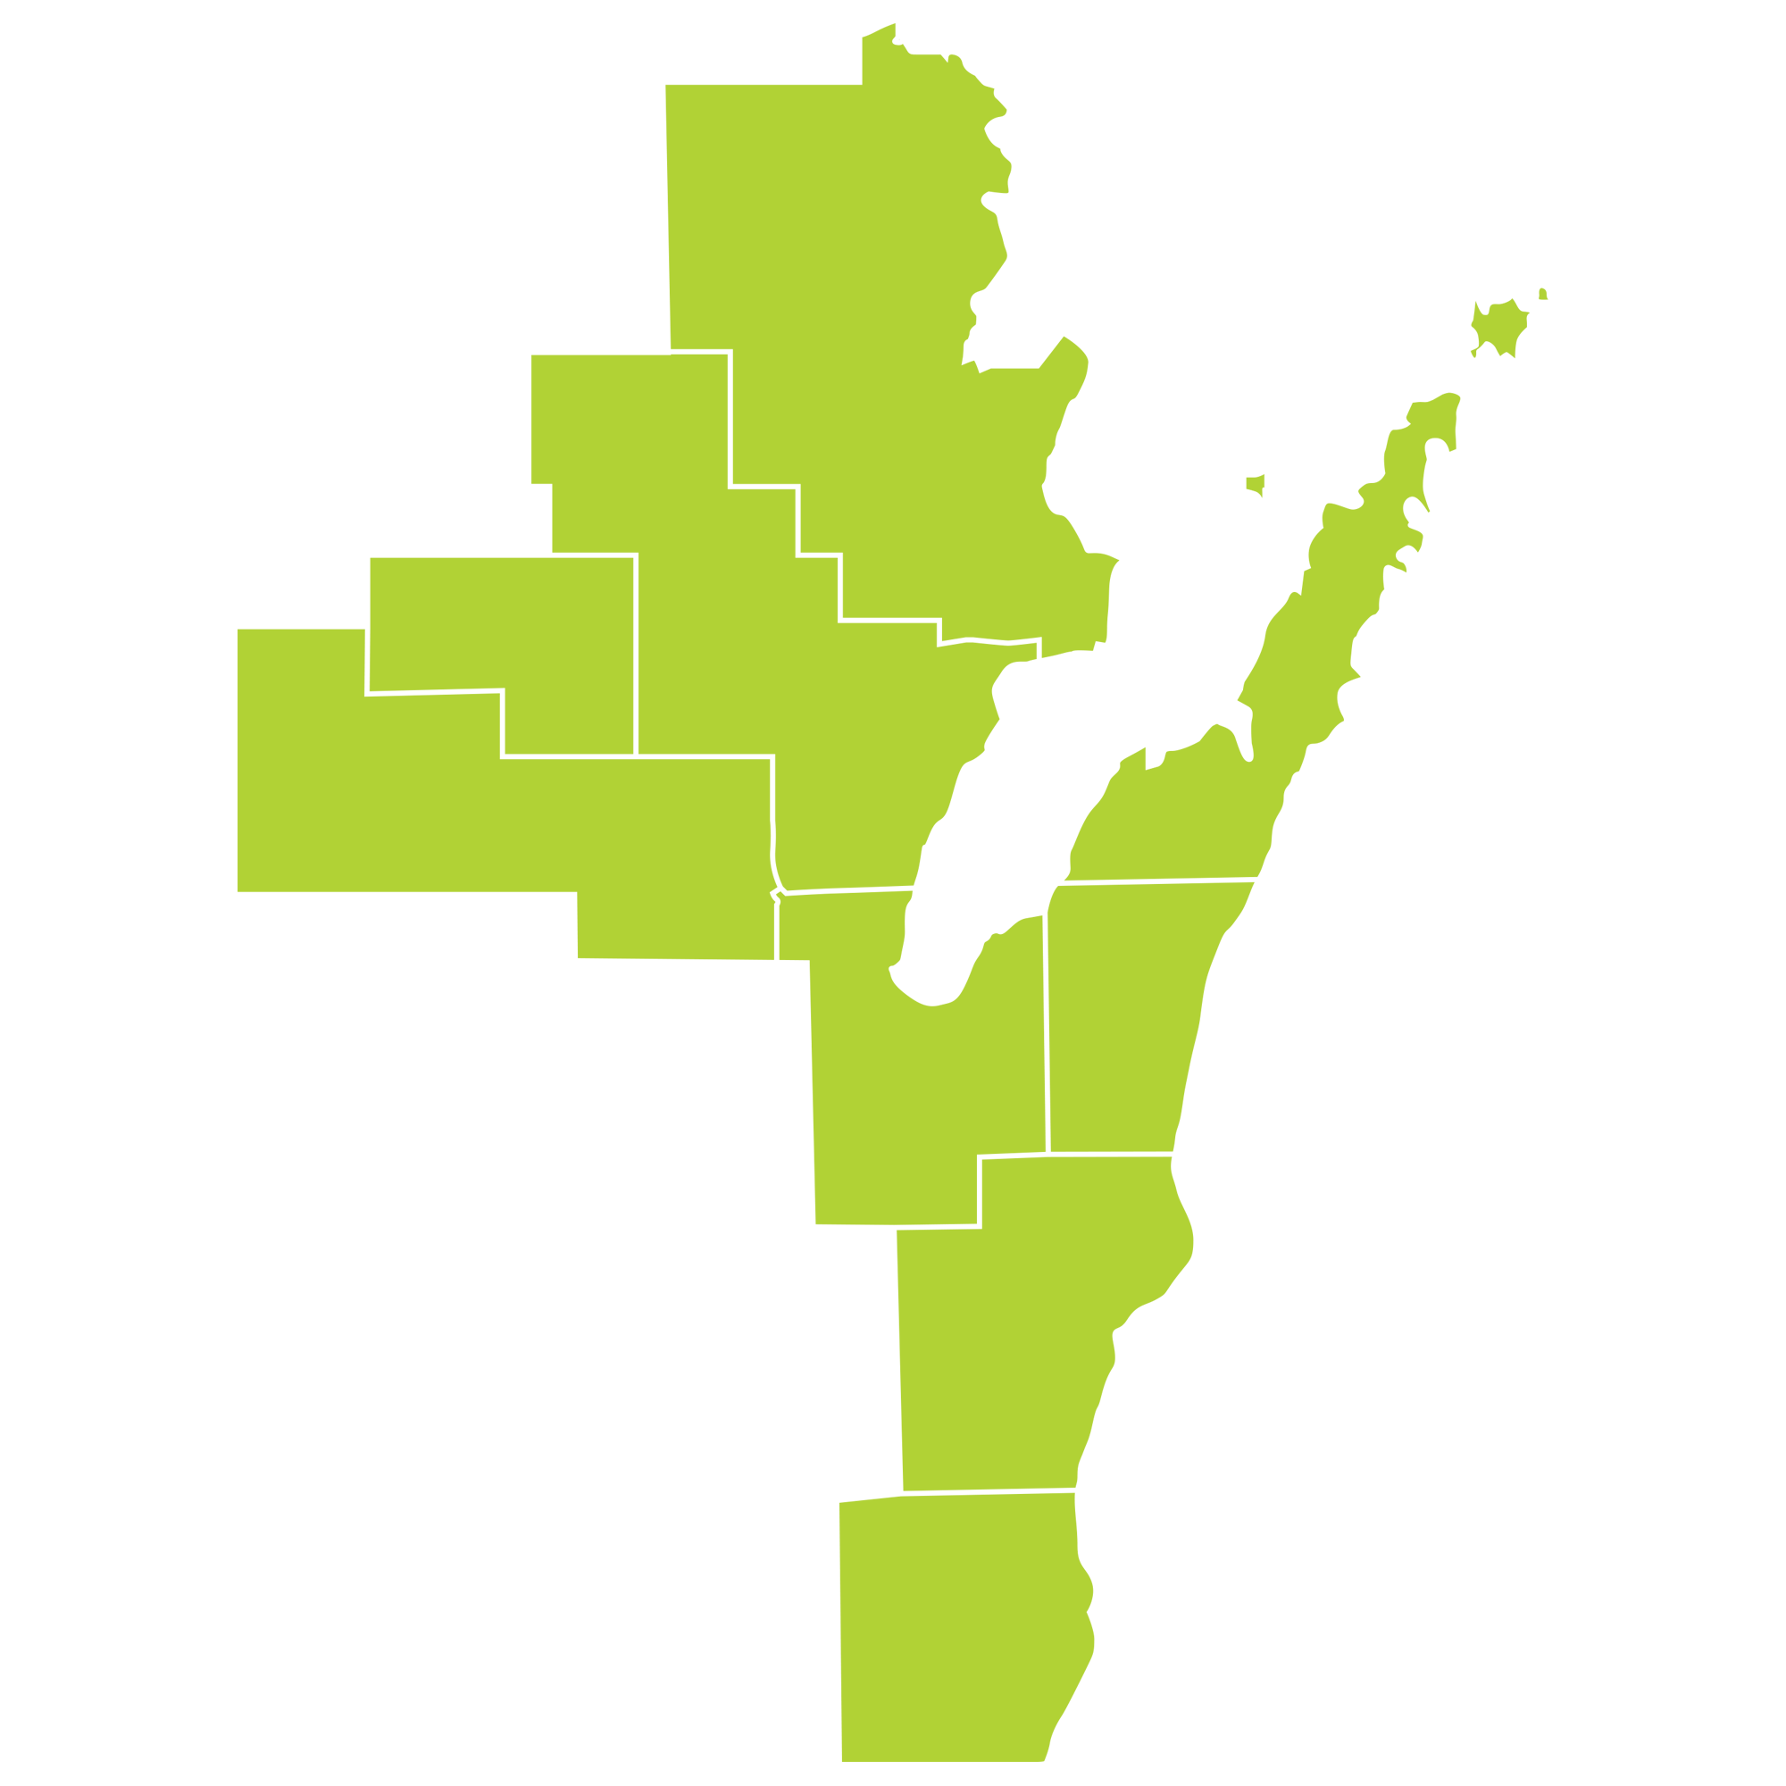
LOCAL PROGRAM MANAGERS - Region 5
5-02 Kathryn Schneider
5-03 Joe Klicka
5-04 Stacey Gilson & Shannon Fahey
5-06 Ruth Hucek
5-07 Kay Behr
5-09 Jane Gondeck
5-10 Amy Tromp
5-12 Tracy Schrader & Paul Baye
5-14 Annette Wuellner
5-15 Joanne Smits & Sam Soik
5-16 Amy Viles
5-19 Justin Steiner & Molly Steiner
5-20 Ben Hughes
5-22 Annie Owens
5-26 Michelle Tankernsley

Slide 7
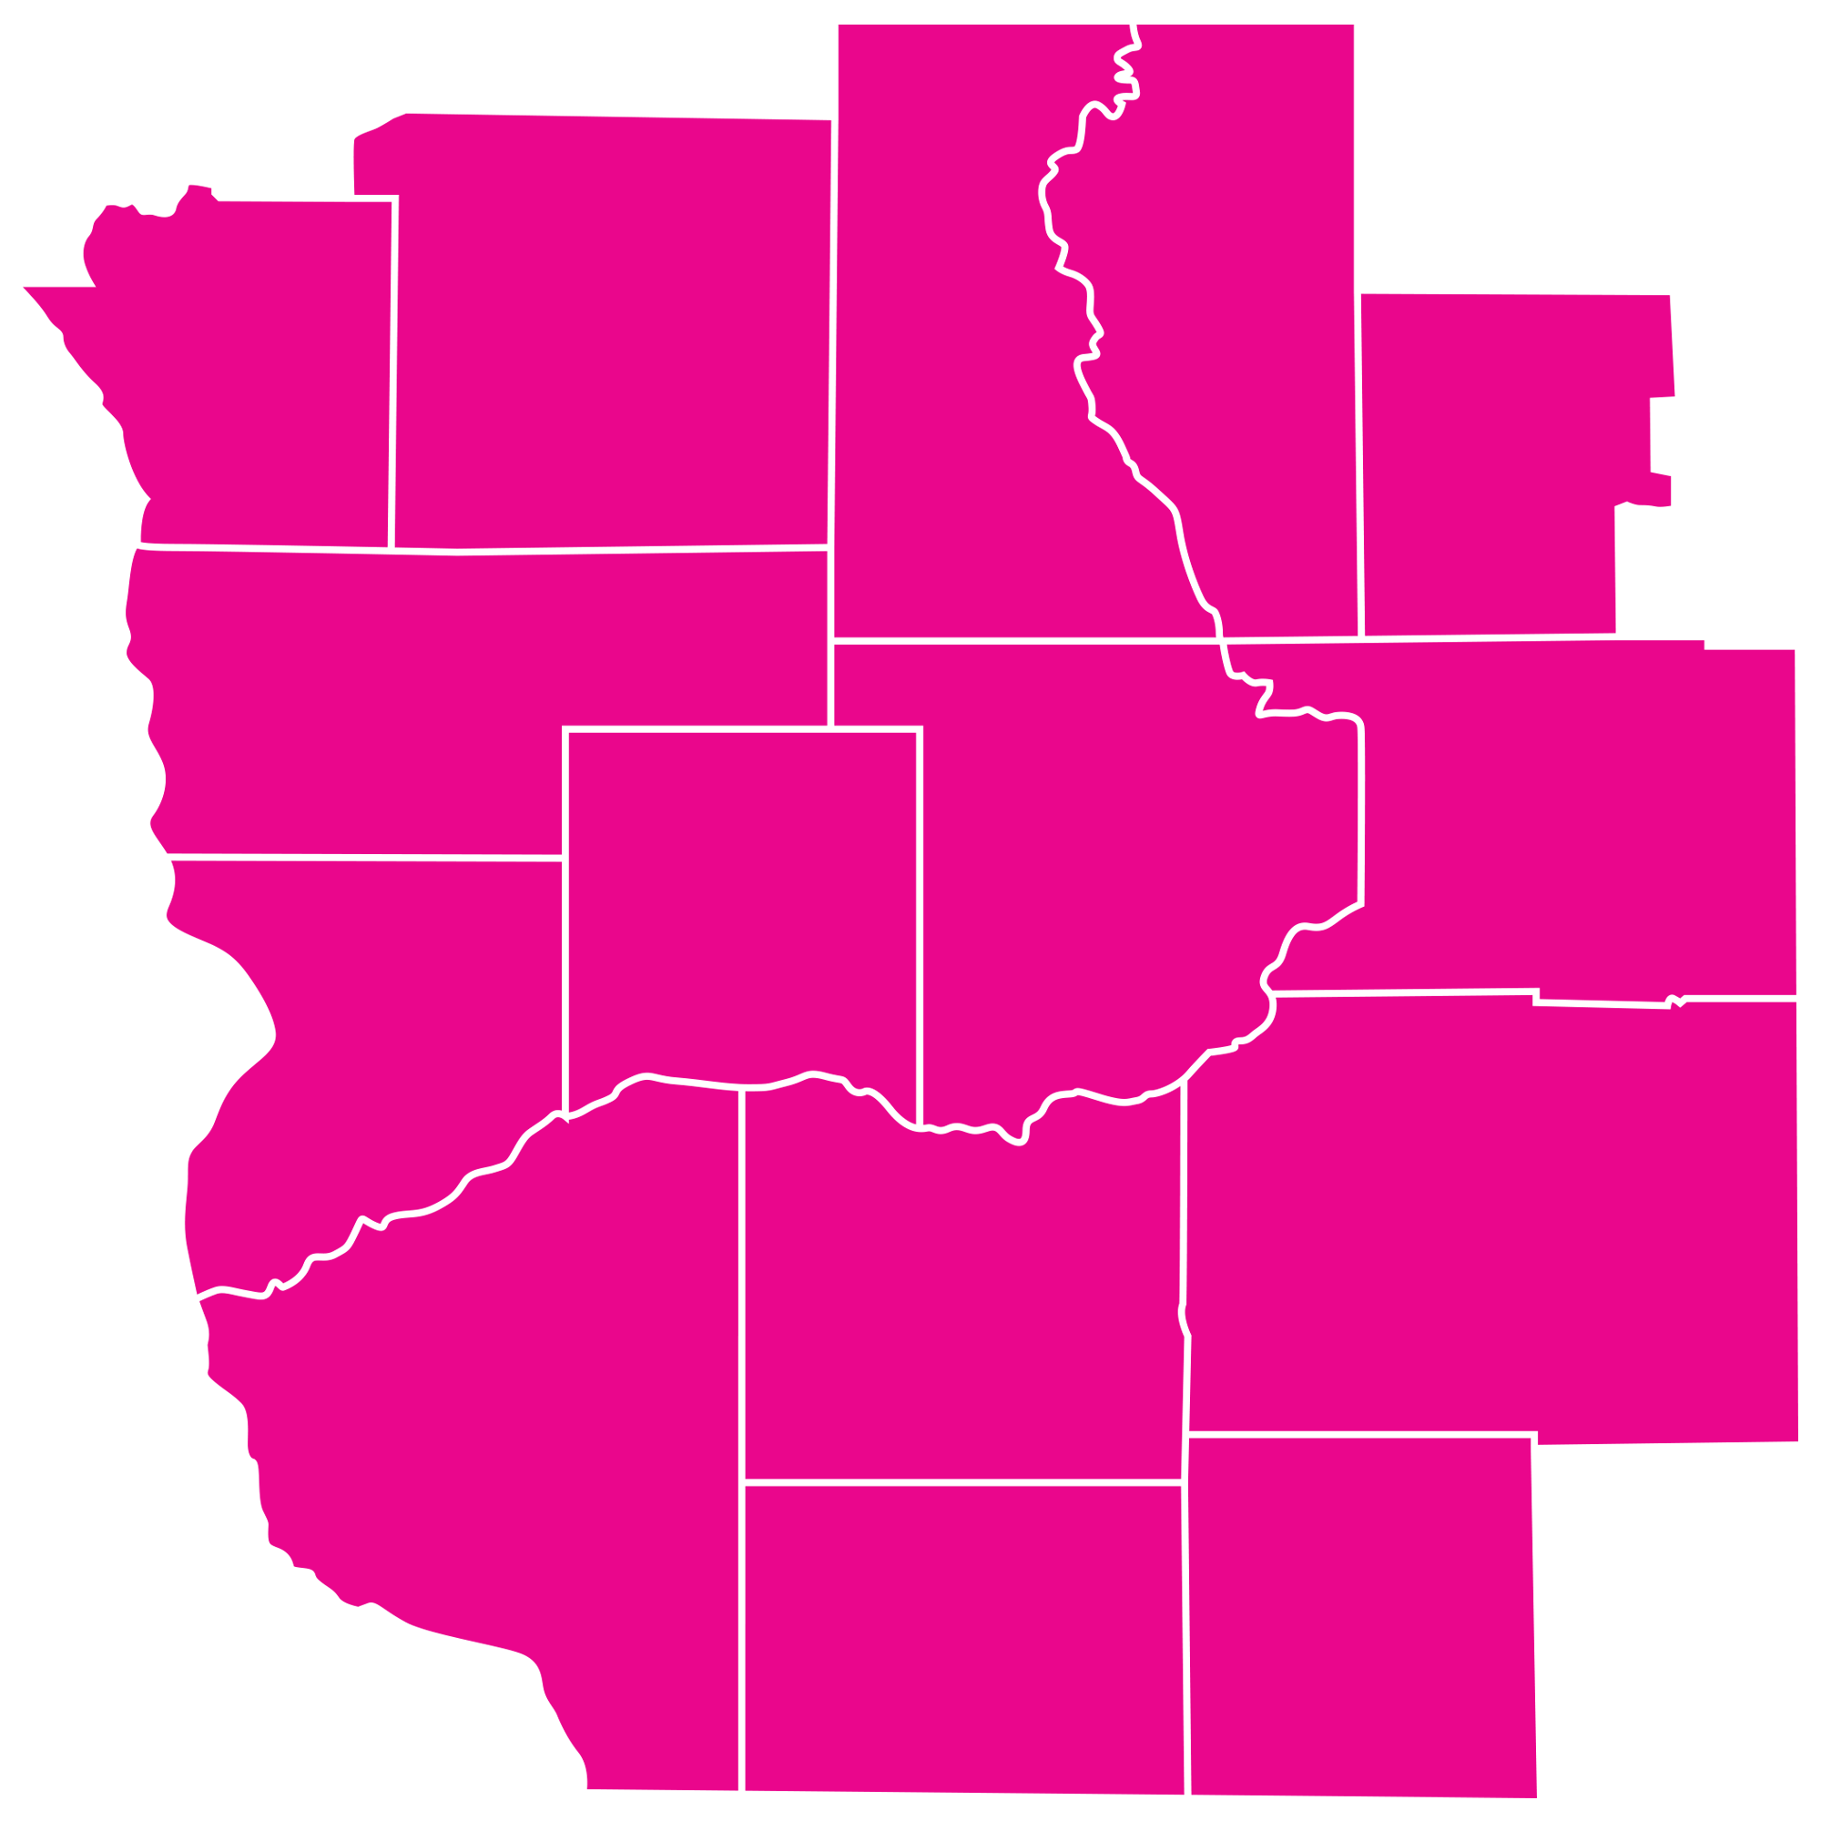
LOCAL PROGRAM MANAGERS - Region 6
6-01 Diana Mielke
6-02 Rebbecca Brunning
6-03 Angela Klien
6-04 Donna Meier
6-05 Elisa Ried
6-06 Michele Walhovd
6-09 David Burton
6-12 Lydena Goosens & Tony Goosens
6-14 Bill Rose
6-15 Loretta Stietz
6-16 Christine Hetzel & Heather Murray
6-18 Jan Davis
6-19 Cheryl Larson & Sonya Winthrow
6-20 Katherine Wildman
6-26 Joe Protz
6-29 Riley Peterson
6-33 Kaitly Peters
6-36 Aimee Schmidt & Kat Craugh
6-40 Angela Endicott
6-44 Mary Dodd
6-47 Karissa Gabel
6-50 Brenda Slovacek
6-52 Amanda Armstrong & Shannon Waiss
6-58 Linda O’Connell
6-60 Vicki Hagen
6-62 Melissa Whitmore
6-64 Kiley McLean
6-65 Amy Ziegelbauer

Slide 8

LOCAL PROGRAM MANAGERS - Region 7
7-01 Matthew Eby
7-02 Lisa Buchanan
7-04 Celia Villanueva
7-05 Kyle Harding
7-06 Warren Schoonover & Tammy Welter
7-07 Marcia Nolan
7-08 Elizabeth (Betty) Aguirre
7-09 Robert Schilling
7-11 Anne Loewen & Cathleen Lewis
7-15 Donna Cornelius
7-19 Richard Dimzoff & Donna McKusker
7-20 Heather Deegan
7-21 Patricia (Patty) Baker-Kraus
7-25 Valerie Donnan & Jennifer Pelletier

Slide 9

LOCAL PROGRAM MANAGERS - Region 8
8-01 Judy Santoro
8-02 Linda Brothen & Kevin Szydel
8-03 Kelly Schmidt
8-05 Dennis Scheer
8-07 Wendy Heyer
8-10 Jodi Dabrowski & Mellisa Kaun
8-11 Lyndsay Linsmeier
8-14 Claudia Derringer
8-17 Robert (Bob) Ziegler
8-19 John Hough & Lynn Hough
8-24 Cynthia Loehr & Margaret Rupnow
8-25 Kris Manske
8-27 Connie Crowe & Sharon Seegers
8-28 Phil Konrath
8-31 Sara Cummings & Becky Cleland
8-32 Craig Mench, Brian Beitz, & Fadara Ounkham
8-33 Mary Fiegel
8-34 Gregory Conrad
8-35 Al Calderon
8-37 Shirley Todor
8-40 Christina Ruddies & Jill Schwitters
8-42 Brenda Seekins
8-44 Ben Godlewski & Alisa Novak
8-47 Skyla Kanter & Aliexis Craft

Slide 10
Special Olympics Wisconsin
Recognition

Slide 11
BRINGING THE EXTRA!
Nominated by peers, below are LPMs who have gone above and beyond
Cynthia Armstrong 8-37
18 years key volunteer for multiple sports, chaperone
David Ashenhurst 8-37
9 years – Head Basketball Coach, motivates athletes and families and actively pursues profession and developmental growth of the athletes.
Janice Bournelis 4-14
10 years Coach, Key Volunteer/Chaperone and LPMT member
Lisa Brill 2-43
10 years – LPM, Coach, Medicals, etc. One woman show
Lisa Buchanan 7-02
LPM, Coach, Equipment Manager, Sports Director – 20+ years
Gloria Capetillo 5-02
21 years volunteering – Coaches multiple sports “helps wherever is needed”.
Bob & Becky Cleland 8-31
9 years Multi-sport Coaches, LPMT, Chaperones, Fundraising, Mentors to athletes and coaches
Rana Costello 4-14
5 years Coach, Key Volunteer/Chaperone and LPMT member
Amy Dignan 7-01
9 years Coaching multiple sports and volunteering for others
Tony Dobson 8-31
4 years Inventor of Adaptive BB event that involves the local schools and community
Tom Fischer 6-05
15+ years Key Volunteer – “Going above and beyond with the track meet concession stand!”
Vivian Gamble 2-39
21 years Key volunteer, Coach, Chaperone “Critical in keeping the program running.”

Slide 12
BRINGING THE EXTRA!
Nominated by peers, below are LPMs who have gone above and beyond
David Hackbarth 2-28
Multi-sport coach, helped grow participation in bowling and athletics, key volunteer
Jean Herman 8-37
19 years – Volunteer, assistant coach, head coach for multiple sports. “Jean shows unwavering commitment to our athlete's success”.
Melissa Hippert 5-14
3 years Co-Mgr., Key Volunteer, coach/Chaperone
Mary Horning 5-02
LPM – 25+ years - Has grown the program from 10 athletes to over 60. Mary is retiring in 2025 – Inspiration to the community
Mary Javurek-Lee 7-01
4 years as a winter games and athletics coach and volunteer
Julie Johnson 2-43
19 years of keeping the program running without support from the school or volunteers
Lorrie Kastner 8-37
19 years Athletes Medical Coordinator, acted as Co-Mgr. and key volunteer
Cheryl Kennedy 5-14
10 years Key Volunteer, Uniform Coordinator, Coach/Chaperone
Angela Lapworth 7-01
13 years as a coach, volunteer and chaperone
Kelly Larson 3-36
20 years as a Financial Coordinator and coach for Bocce and bowling
Rosanna Lopez-Jahnke 8-37
4 years handling uniforms, volunteers
Donna McMullen 8-37
19 years Key Volunteer, Bowling Coach, mentor

Slide 13
BRINGING THE EXTRA!
Nominated by peers, below are LPMs who have gone above and beyond
Ronnie Mellinger 8-27
Athlete Medical Records Coordinator, Head Coach for multiple sports, mentor and role model
Jackie Michlig 8-37
14 years Coach and Key Volunteer
Renee Olig 4-14
10+ years Coach, Key Volunteer/Chaperone and LPMT member
Jane Pribek 5-14
Former LPM, Current LP Treasurer and LPMT, Coach/Chaperone, Mentor
Candi Rynders Schneider 8-37
19+ years as a Former LPM, coach/volunteer for various sports and Polar Plunge/Event coordinator
Nicole Saal 2-28
3 years Coach, Key volunteer/chaperone, LPMT, helped grow swim program and mentor
Loren Styba 8-37
8 years – Handles communication on practices, weather and volunteers with multiple sports
Mary Styba 8-37
19 years Key Volunteer and coach
Jim Tikalsky 5-02
14 years volunteering as coach for swim, “without Jim there would be no swim program”
Donna Zientek 8-37
30+ years volunteering – Financial Advisor, Mentor, and Coach
Roger Zientek 8-37
18 years Multi-sport coach, volunteer and chaperone

