Slide 1
Sports Updates

Slide 2
Sport Evaluation
  Process
    Consistency in decision-making
    Benchmarks for adding or removing sports
    Reference SOI model and other state program’s adaptations
Considerations
    Popularity of the Sport
    Venue Availability
    Sport Seasons and Calendar
    Capacity and Resources

Slide 3
Sport Benchmarks
Levels of Competition
    Recreational
    Invitational
    Regional/District
    State
Benchmarks
    Athlete Participation - 2% (160 Athletes)
    Local Programs Competing – 10% (13 Local Programs)

Slide 4
Current Data – Athlete Participation
Sport | # of Athlete Participants | % of Athlete Participating
Alpine Skiing | 22 | 0.27%
Cross Country Skiing | 12 | 0.15%
Snowboarding | 2 | 0.02%
Snowshoe | 81 | 1.01%
Basketball | 1473 | 18.33%
Basketball Skills | 470 | 5.85%
Swimming | 362 | 4.50%
Athletics | 1211 | 15.07%
Cornhole | 686 | 8.54%
Soccer | 122 | 1.52%
Powerlifting | 80 | 1.00%
Tennis | 31 | 0.39%
Golf | 101 | 1.26%
Bocce | 808 | 10.05%
Softball | 540 | 6.72%
Tee Ball | 64 | 0.80%
Flag Football | 157 | 1.95%
Volleyball | 235 | 2.92%
Bowling | 2868 | 35.69%

Slide 5
Current Data – LP Participation

Slide 6
What’s the need for changes?
To keep SOWI expenses in line with revenue
Goal is to provide consistency and efficiencies to maximize the budget
Create changes that provide cost relief with minimal impact to athletes and local programs

Slide 7
2026 Fall Games Change
Moving State Fall Games to DeForest Sports Complex
  Venue
    Same quality of venue as Woodside
    Significantly lower cost than Woodside Sports Complex, WI Dells
  Hotel
    Lower cost hotel options for local programs vs Chula Vista
    Reduction in staff lodging costs
  Food
    Partner Engagement

Slide 8
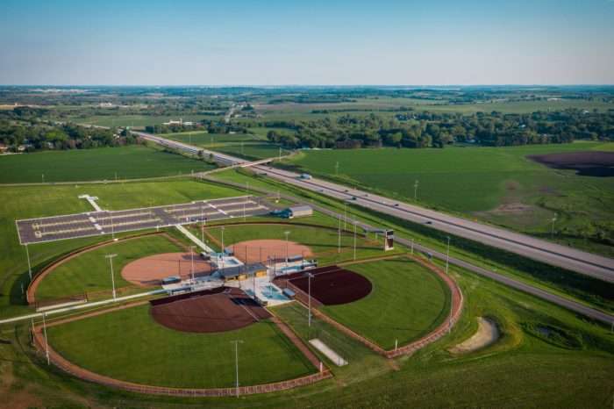
DeForest Sports Complex

Slide 9
Additional Changes
Offering Winter Games as an Invitational
    3 out of 4 sports under 10% local program involvement
    4 out of 4 sports under 2% athlete participation
    Weather causing infrequent offering and unsafe training conditions
Eliminating Sectional Basketball
    Reduction in Competition numbers post-COVID
    Sectional Basketball was added when SOWI had 200 teams (164 teams in 2025)
    Would be reconsidered if participation numbers increased in future years
Regional Bowling as State Bowling
    Venue Changes
    Reduced travel and expense for Local Programs
    1st-3rd awarded with medals
Tennis and Soccer moved to Invitational

Slide 10
Additional Information
SOWI will continue to support Invitational level sports
  Rule updates
  SOWI Invitational Grant
  Non-SOWI event participation
Sports moved to Invitational status would be reconsidered for Regional/District/State competition if participation hits one of 2 benchmarks
Communication
  Email will be sent out Monday with this information
  Update will be provided in future Inspire newsletter
  Form for questions about 2026 changes
    SOWI staff will respond via email
    Questions will be recorded for a FAQ document to be shared at a later date

Slide 11
National Invitationals
Resume participation in SONA Invitationals June 30, 2026
Local Programs will have designated accounts per National Invitational
Local Programs can contribute up to $200 per person to registration fees from LP Funds
Local Program/Participant is responsible for costs of attending

Slide 12
National Invitationals
SOWI will have a National Invitational Dashboard with information about upcoming events and link for shared information
National Invitationals are quota based
  SOWI Submits all request
  SONA provides number
  Weighted draw to select
One person will be designated HOD

