Slide 1
Special Olympics Wisconsin
2025 SOWI Fall Meetings

Slide 2
WELCOME
…with gratitude

Slide 3
Our Mission
Setting the Tone…
The mission of Special Olympics is to provide year-round sports training and athletic competition in a variety of Olympic-type sports for children and adults with intellectual disabilities. This gives them continuing opportunities to develop physical fitness, demonstrate courage, experience joy and participate in a sharing of gifts, skills and friendship with their families, other Special Olympics athletes and the community.

Slide 4
Video Message
Eunice Kennedy Shriver

Slide 5
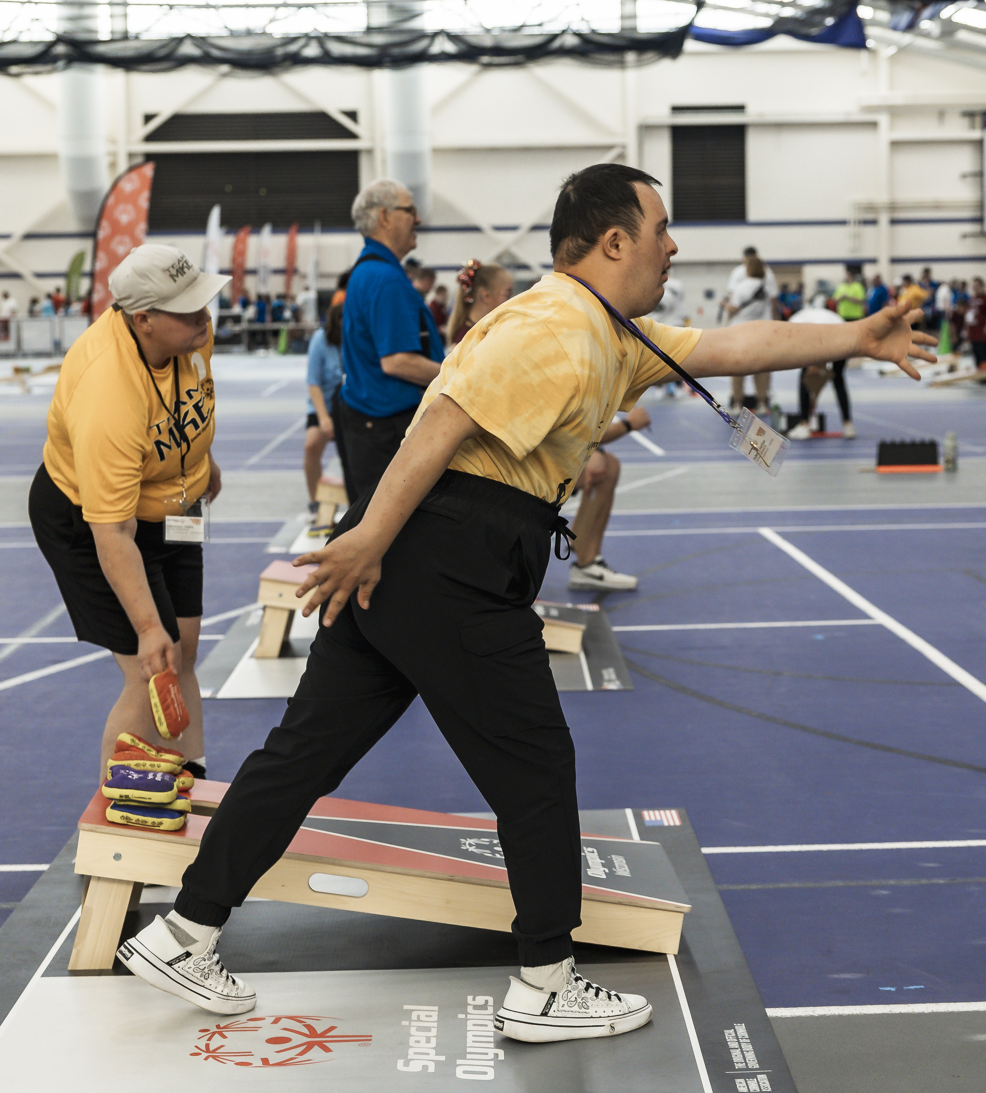
The Day’s Goals
Listen
Learn
Lead

Slide 6
Video Message
Tim Shriver

Slide 7
"Let me win, but if I cannot win, let me be brave in the attempt."
– Athlete Oath

Slide 8
Special Olympics Wisconsin
Leadership Grant and Athlete Leadership | September 20th, 2025

Slide 9
Who are we?
Lexi Galarowicz: Unified Leadership Specialist
  Athlete and Special Olympics Wisconsin employee
  Mgalarowicz@specialolympicswisconsin.org
Deb Moore-Gruenloh: Athlete Leadership Coordinator
  Long time Volunteer and Coach

Slide 10
Athlete Leadership

Slide 11
What is Athlete Leadership?
Athlete Leadership is a program offered to Special Olympics athletes to help them gain more leadership skills at the personal, local, and statewide level.
We currently offer 12+ classes a year for new and returning athlete leaders.

Slide 12
How do I become an Athlete Leader?
To become an Athlete Leader, here are the steps to take:
  Contact Special Olympics Wisconsin Athlete Leadership
  Take an Athlete Leadership Course that interests you.
  Help out with different events locally or statewide.

Slide 13
Classes
Remaining for 2025:
Heath Messenger: Virtually, Wed Oct. 1st- 22nd from 6pm-8pm
Athletes as Coaches: In Madison, Sat November 8th
Introduction to Athlete Leadership and Understanding Leadership: Virtually, Tues/Thurs December 2nd and 4th from 6pm-8pm
The 2026 Class Schedule handout is in your folder with more information.
Notes:
*Have a handout for the Class Schedule of 2026*

Slide 14
Grant Projects
Leadership Grant Recipients

Slide 15
What is the Grant?
We were awarded this leadership grant through Special Olympics North America (SONA). We were one of seven states to receive this funding and dispersed mini grants to 10 athlete leaders around the state.
States that received this grant: WI, OH, MD, SC, KS, UT, ID

Slide 16
Purpose of the Grant
The purpose of this grant was to bring more athlete leadership representation to the local program level. Each grantee was able to come up with a project important to them to implement locally. This also gave them a chance to show their community what athlete leaders can do.

Slide 17
Project Breakdown
Recruitment- 3
Health-2
Athlete Leadership- 2
Marketing-1
Unified Champion Schools- 2

Slide 18
Recruitment
2-12: Neillsville
2-44: Wisconsin Rapids
3-25: Menomonie Red Cedar

Slide 19
Increasing our Athlete and Volunteer Membership
Who: Kolin Schmitz and Jene and Denny Miller
Program: 2-12 Neillsville
Attended multiple community parades to spread awareness and recruit more local athletes and volunteers.

Slide 20
All of us R Together (ART)
Who: Samuel Swartwout and Birgit Swartwout
Program: 2-44 Wisconsin Rapids
Gathered pieces of artwork from students with intellectual disabilities to raise awareness and display at an art fair.

Slide 21
Recruiting younger Athletes and LETR Officers
Who: Danny Cox and Joel Wener
Program: 3-25 Menomonie Red Cedar
Spoke with multiple police departments to spread awareness surrounding LETR, also worked with Menomonie School District to recruit younger athletes to join their Local Program.
The school then registered as a Unified Champion School!

Slide 22
Health
4-04: Dodge County
6-36: La Crosse

Slide 23
Leadership and Health Grant:
Dining with Danielle Healthy Meal Sessions
Who: Danielle Miller and Mary Pat Boschert
Program: 4-04 Dodge County
Taught about nutrition and healthy habits, while also giving athletes the opportunity to improve their cooking skills.

Slide 24
Wheely Awesome Bike Club
Who: Renee Cappetto, Braedan Calvillo and Sophie Nedens
Program: 6-36 La Crosse Parks and Rec
Started a Bike Club to encourage local athletes to socialize & have fun while being active and getting outside.

Slide 25
Athlete Leadership
2-25: Stevens Point
4-25: SOAR Fox Cities

Slide 26
Offering Athlete Leadership Training for those in Central Wisconsin
Who: Tyler Wigington and Kristy Bridenhagen
Program: 2-25 Stevens Point YMCA
Coordinated with Special Olympics Wisconsin to host an Introduction to Athlete Leadership & Understanding Leadership class in the Steven's Point area for local athletes.

Slide 27
SOAR to Leadership
Who: Christiana Coakley and Ebben Wydeven
Program: 4-25 SOAR Fox Cities
Coordinated with Special Olympics Wisconsin to host an Introduction to Athlete Leadership & Understanding Leadership class in the Fox Cities area for local athletes.

Slide 28
Marketing
8-05: Wauwatosa

Slide 29
Resource Guide for Wauwatosa
Who: Kyle Von Drasek and Allie Kaiser
Program: 8-05 Wauwatosa
Created a community resource guide to increase awareness surrounding accessible opportunities and resources local to Wauwatosa.

Slide 30
Unified Champion Schools (UCS)
6-12: West Madison
8-31: Hartford

Slide 31
La Follette Unified
Who: Trevor Thwing and Zevyn Goossens
Program: 6-12 West Madison
Hosted a Whole School Engagement event at a home basketball game for Spread the Word Inclusion Week. Also recruited their school to register as a Unified Champion School.

Slide 32
Slinger Unified
Who: Sara Byrd and Martha Stollberg
Program: 8-31 Hartford Parks and Rec
Hosted a banner signing for Spread the Word Inclusion Week and spoke to a Peers-to-Peers class about her experience as a Special Olympics Wisconsin athlete.
The banner was signed by over 200 people!

Slide 33
What Next?
We applied for a new grant, we will know if we received it in November.
Projects may vary, but it will still be athlete leader led.
If you're interested in participating, please contact Lexi at: mgalarowicz@specialolympicswisconsin.org

Slide 34
Questions?

Slide 35
"Let me win, but if I cannot win, let me be brave in the attempt."
– Athlete Oath

Slide 36

Up and Moving
Jeston Glish – Health Program Manager

Slide 37
Local Program Task Force
2025 SOWI Fall Meeting| September

Slide 38
Agenda
SONA and Local Programs
Local Program Task Force
Local Program Structure
Minimum Standards
Staff Communication/Support

Slide 39
SONA
TBD

Slide 40
Local Program Task Force
Members
  Michelle Fulweber (3-12 Chequamegon Bay)
  Kristy Bridenhagen (2-25 Stevens Point YMCA)
  Linda Brothen (8-02 North Suburban)
  PJ Lynch (8-42 Team Milwaukee)
  Heather Holland (2-17 Marshfield)
  Chad Hershner (SOWI)
  Mark Wolfgram (SOWI)
  Robin Van Fleet Bergen (SOWI)
  Jason Blank (SOWI)
  Amie Dugan (SOI/SONA)
  Jeremie Ballinger (SOI/SONA)

Slide 41
LP Task Force Purpose
Look at Local Program structure and processes to find gaps, changes, or needs
Agreed upon vision for Local Program Task Force: Creating equitable experience for all Special Olympics Wisconsin athletes
Main topics:
  Local Program Structure
  Consistency in all Local Programs
  Staff support and communication for Local Programs
Sustainable, quality programs

Slide 42
Statewide Structure (Current State)
SOWI has a variety of scenarios in our local program structure
• Size of Programs
• Types of Local Programs
• Structure of Programs
  Some are lead by one or two people
  Others have a team and formalized structure
  Some charge athletes to complete – others don’t
• Challenges and opportunities vary by program/region

Slide 43
Local Program Breakdown
125 Local Programs - Type
  Community Based – 74
  School Based – 37
  Park & Rec – 6
  Rehab Facility – 3
  Y Program – 2
  Church – 1
  Camp – 1
  Arc Program – 1
TOTAL ATHLETES BY REGIONS:
2024: R2: 595 │ R3: 691 │ R4: 705 │ R5: 711 │ R6: 1070 │ R7: 977 │ R8: 1,551
2025: R2: 580 │ R3: 701 │ R4: 708 │ R5: 625 │ R6: 1273 │ R7: 902 │ R8: 1,557
522 Class A Certified Coaches

Slide 44
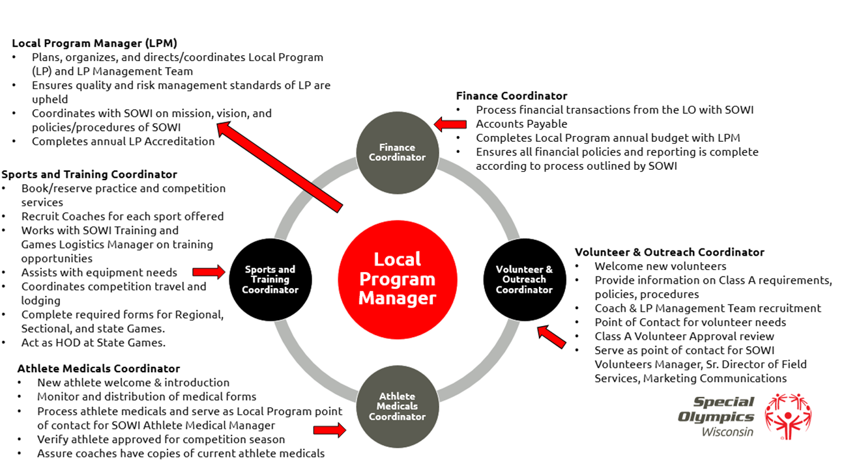
Local Program Structure
Notes:
*Athlete leadership incorporated throughout the Local Program

Slide 45
Additional Local Program Positions
Health and Fitness Manager
Assist in training with Sports Manager
Assist with Nutrition
Interacts with SOWI Healthy Athletes initiative
Equipment and Uniform Manager
Assist with general maintenance of equipment
Tracks need for equipment utilized for training within the LP
Maintain needs and distribution of LP uniforms
Works with SOWI Marketing and Communications on proper uniform compliance (logos, etc.)
Unified Champion School Manager
Coordinate Unified Sports including liaising with Unified Champion Schools, Park & Rec, and transition plans for 11+ year olds into community programs

Slide 46
Additional Local Program Positions
LETR Manager
Coordinate Law Enforcement Torch Run activities with the LP Mgmt. team including Torch Run, Cops on the Roof Top, awards, local picnic/community interactions
Works with SOWI LETR team
Fundraising Manager
Work with community to support the LP on fundraising efforts
Plan and implement fundraising efforts
Donor acknowledgement
Work with SOWI Development and Special Events on state fundraising efforts such as Polar Plunge, LETR Torch Run, Run with the Cops, etc.
Interact with LP Treasurer on the handling and processing of funds from fundraising efforts

Slide 47
Additional Local Program Positions
Marketing/Communications Manager
Updates webpage and social media
Verifies compliance to policies of social media guidelines within SOWI
Assists with community outreach
Assists with LP appreciation cards, letters for donors and volunteers
Assist with internal communication via emails, texts, newsletter
Provide content to SOWI Marketing and Communications regarding LP stories and LP content

Slide 48
Local Program Minimum Standards
Minimum of 15 Athletes and Unified Partners
Maintain a 4:1 ratio of volunteers per athlete with a minimum of 4 Class A Volunteers
Local Program Management Team consisting of:
  Local Program Manager/Finance Manager
  Volunteer and Outreach Manager
  Athlete Medicals Manager
  Sports & Training Manager
Provide training and register to compete at a Regional, District, or State in 3 sports throughout the year in at least 2 sports seasons
*Include state attendance*
Encourage to participate in Health Programming
Notes:
Goal is not to police but to support and provide consistency and quality

Slide 49
Local Program Minimum Standards
Local Programs place athletes in positions of leadership at the local level and connect them with SOWI Athlete Leadership programs when appropriate
Communication Standard: Provide monthly updates to Coaches, Volunteers, Athletes, and Families
Fill out annual Accreditation
  Local Program Budget
  Local Program Succession Plan
Timeline: In place by January 1, 2028
Notes:
If programs can’t meet minimum standards, talk to SOWI so we can work together.

Slide 50
Staff Communication
Athletic Directors are the primary point of contact
Exceptions:
  Volunteers – volunteer@specialolympicswisconsin.org
  Financial – accountspayable@specialolympicswisconsin.org
  Severe Suspensions – Sr Director of Field Services
SOWI Staff Communication Expectations
  Creation of SOWI Local Program White Pages
  Respond within 2 business days
    Utilization of Out of Offices
    Follow up date if can’t answer within 2 business days
  Reply by add the SOWI contact rather than forwarding the email

Slide 51
Special Olympics Wisconsin
New Athlete Paperwork 2026

Slide 52
Who?
Special Olympics, WI is required to implement new athlete paperwork created by SOI as of January 1st, 2026.
The new athlete paperwork policy affects new athletes and athletes who need to renew their paperwork.
Current athletes with a valid medical on file do not need to complete the new paperwork until it is time for them to renew.

Slide 53
What?
The new athlete paperwork consists of:
      The Athlete Registration Form ….and that’s it! No more Athlete Release, Health History, Physical Exam, or Communicable Disease Waivers.
SOWI and its affiliated local programs will not be allowed to require a medical form to be completed in order for an athlete to participate in practices, district, regional and State competitions.

Slide 54
When?
Beginning January 1st, 2026
Any previously used forms will not be accepted.
“Medical” deadlines will still be enforced.
  The waiver section now includes information on Atlanto-Axial Instability and a Release of Liability/Assumption of Risk/Indemnification.

Slide 55
Why?
Registration process is easier for athletes and families by removing the barrier of getting a physical examination prior to participation.
Ensures essential health information is collected.
The previous Athlete Medical Form has been determined by SOI as complex and challenging for some athletes and families to complete.
The information collected on the new Athlete Registration Form has been determined by SOI as the minimum essential information needed by coaches.

Slide 56
How?
Forms still need to be sent to the Madison Headquarters office via mail or email.
The new Registration Forms will be valid for 1 year from the date they are signed, not submitted.

Slide 57
The “But”
There is a new medical form that will be used in the following circumstances:
  Athletes participating in USA, Regional and World Games.
  MedFest screenings - SOWI encourages all athletes to have a yearly examination.
  Current athletes with a medical restriction will need the new medical or dr. release to lift their restriction.

Slide 58
Questions?

Slide 59
Coaches Training Updates
New Process & Levels Breakdown

Slide 60
Why the change?
Current process is very vague in training sport specific information for our coaches. It is doing them & our athletes a disservice by not training them appropriately.
Want to give our coaches the opportunity to continue learning and progressing in their coaching journey.
More aligned with SONA’s level system, allowing a smoother process for coaches to coach at National or World Game opportunities.

Slide 61
Concerns we Addressed
Having all trainings/needs in one place:
  All trainings and qualifications needed to coach at SOWI events will be uploaded to Voluntaro. Making it easy for coaches to track what they need & what their expiration dates are.
  There will be some courses in the SONA portal, but these are NOT required to coach at SOWI events
Time Commitment
  The aim of all the trainings is to have them shorter, or as long, as the current coaches certification (45 minutes). We want to be vigilant of our volunteers time, while giving them the information needed.

Slide 62
Concerns we Addressed
Up-to-date Information
  The courses will update with accurate rules information moving forwards. Rather than recycling the same course for our coaches every 3 years, there will be updates in the re-certification courses that will be required.

Slide 63
Structure
Bronze (Level 1) | Silver (Level 2) | Gold (Level 3)
Assistant Coach | State/Regional Events Head Coach | USA/World Games Coach
All Class A requirements Concussion Course (Required every 3 years) Signed Coaches Conduct General Coaches Cert (Renamed Coaching Orientation) (Required every 3 years unless taking sport specific course) | All Bronze Requirements SOWI Sport Specific Course (Re-taken every 3 years to keep updated on rules & events) | All Bronze & Silver Requirements. NGB or NFHS course in sport. One of the following: - A SOWI Sport Specific course, different from what they are already trained in. Sports Rules Article 1* Planning a Training Session* Planning a Season* Sports Nutrition for Coaches* OR Fitness for the Sport Coach* First Aid / CPR Course**
* Course is hosted on the SONA elearning portal
** Course is hosted by the Red Cross Foundation

Slide 64
Existing Certification Level
ALL coaches who are certified on 01/01/2026, will automatically become Silver Level coaches.
Providing that ALL Class A requirements are also met.

Slide 65
Gold Level
When a coaches reaches Gold level, they are ready to coach at National / World Games. The requirements for this level are the same as SONA, to make things easier for our coaches to have this opportunity.
We recognize that we have a number of coaches who have been coaching for a long time and know their sports inside out. SOWI will make the decision whether these coaches need to continue to take recertification courses. They will have to retake any Class A or concussion course every 3 years. (Please be patient as we work through this!)

Slide 66
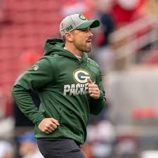
Examples
Matt LaFleur chooses to coach Flag Football for SOWI.
He meets the Gold requirements for having the appropriate sport coaching qualifications. However, having never worked with SO Athletes before, he would still need to take the Class A requirements, and the Coaching Orientation before he can be classified as a Gold Level coach.

Slide 67
Examples
Joe’s daughter is now old enough to participate in SOWI events and is interested in competing in Cornhole. Their program does not have a Cornhole coach, and Joe has never coached before.
Joe will need to complete all the Class A requirements, the Coaches Orientation and the Cornhole specific course, so that he is able to coach his daughters team at a SOWI event.

Slide 68
Examples
Mary has been coaching for SOWI for 10 years. Her program has just started offering Tennis to their athletes. Mary has never coaches Tennis before, but has her sport specific training for Soccer.
She will still need to take the Tennis sport specific course so that she can coach Tennis at a SOWI event.

Slide 69
Why Sport-Specific?
To ensure that our coaches understand the rules for events.
To give a base knowledge of how to coach different skills & requirements for the sport. Benefitting our athletes!
The re-certification courses will be a refresher on rules & techniques to maintain & knowledge. Quicker than the General Coaches Cert re-take!

Slide 70
What if the Coach coaches multiple sports?
They need to take the Sport specific course for each sport. However, with each course lasting 3 years, they can spread out when they take different courses over three years.
There might be scenarios where coaches with extensive knowledge of the sport (based on time coached, qualifications) won’t need to retake the sport specific course, and we can keep them active in that sport.

Slide 71
What about the General Coaches Cert Expiration Date?
New Coaches Orientation course will be uploaded just before the New Year. This will still have a three year expiration.
We are honoring any existing expiration dates. So, if a coach takes the Coaches Cert on 11/02/2025. Their expiration, regardless of sport specific courses, will be 11/02/2028. They just need to re-take the coaches orientation, or their sport specific course before this date to become active after this date.

Slide 72
Questions?

Slide 73
THANK YOU!

Slide 74
Special Olympics Wisconsin
Registration Paperwork and Divisioning

Slide 75
Types of Divisioning
Individual Sports
  Based on:
    Time
    Distance
    Age/Gender (not in all cases)/
Team Sports
  Qualifying games (min. of 2 required)
    Information shared

Slide 76
Registration Forms
For Team Sports
  The more information the better - Detailed Notes
  Information about both teams and match-up helps in divisioning accuracy
  Readable information

Slide 77
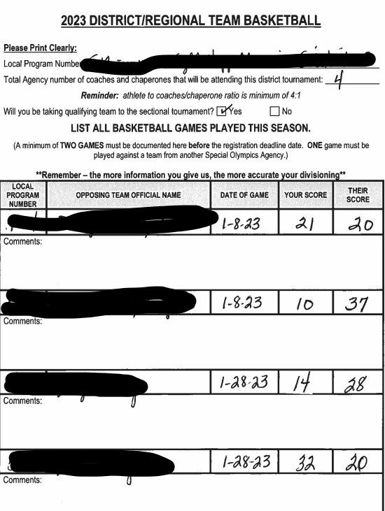
Registration Form
A close game and some blowouts. Understanding why is key
  Players missing?
  Better team?

Slide 78
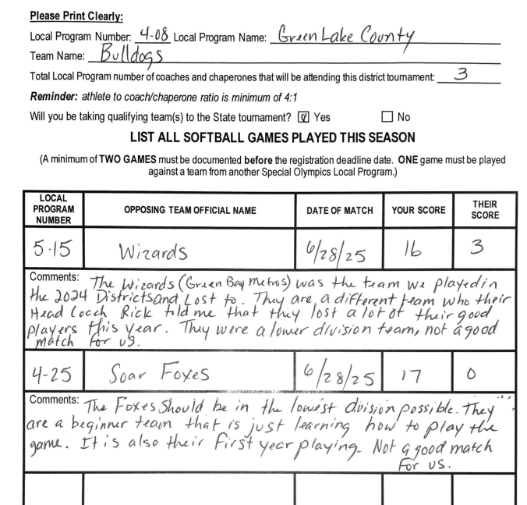
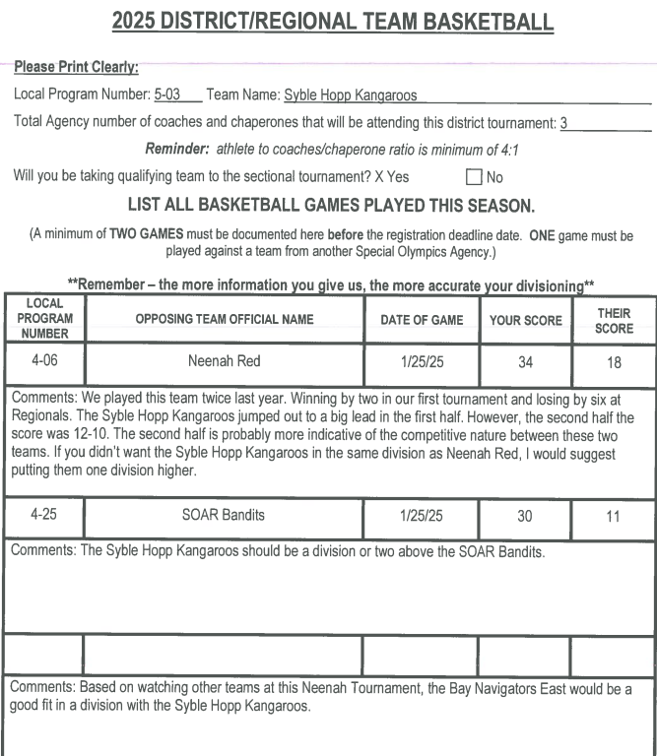
Received Registration Form

Slide 79
Divisioning Keys
Information coming from one individual not multiple
  Unable to know when all received
  Having to transfer information into 1 document

Slide 80
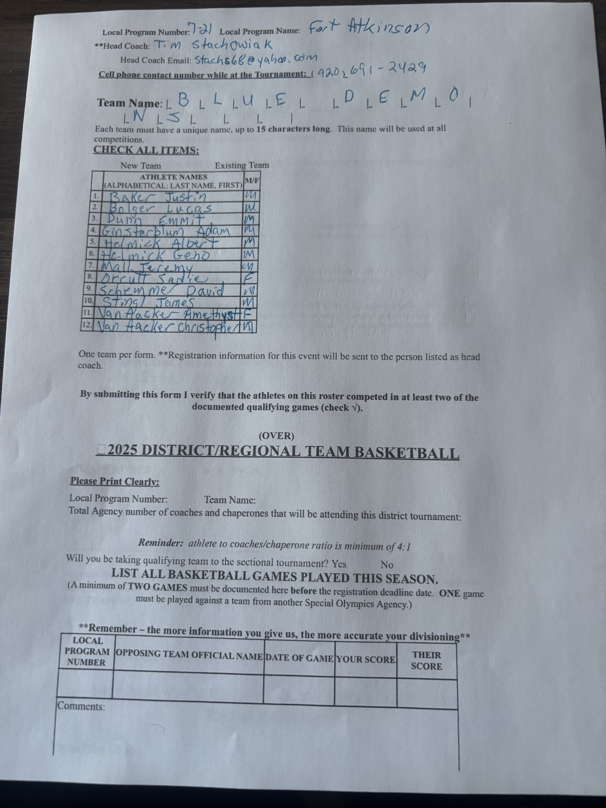
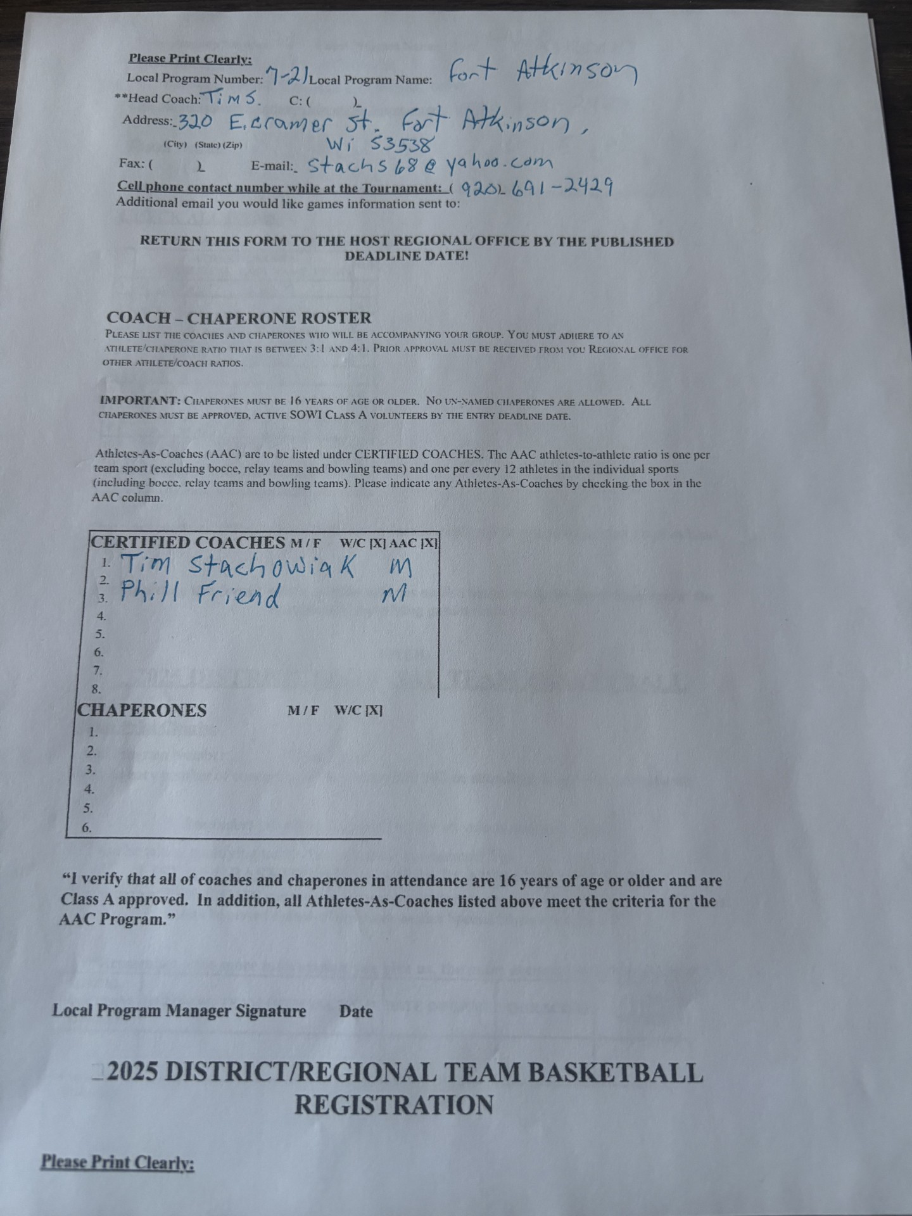
Received via Text - phone

Slide 81
Divisioning keys cont.
Can no longer accept registration forms sent from a picture on a phone Difficult to read – information unreliable and illegible
  Difficult to download

Slide 82
Received Registration Form
Types of Handwriting received:
  Samples of handwritten styles or Local Program or Another Style Finally another sample of received style
  Everyone is unique in their styles, but some just take a bit longer to understand and to prevent confusion when handwriting, please print.

Slide 83
Request for One means of submittal
SOWI ADs currently receives registration forms via:
  Regular Mail
  Email
  Zoom Text message
  Personal phone Text Message
*Must use the online registration forms and scanned/emailed to the Regional AD*

Slide 84
Special Olympics Wisconsin
Sports

Slide 85
2025/2026 Sports Season

Slide 86
Special Olympics Wisconsin
Operations

Slide 87
Who do you call??
Volunteers?
Coach training?
Tournament registrations and fees
Accounts Payable?
Gift Receipts
Month-end financials
Allowable/Non-Allowable Expenses
Community Event Fundraisers

Slide 88
Allowable Expenses
Coach and athlete uniforms
Volunteer fuel reimbursement
Gift card for volunteer appreciation
Outreach materials
Celebration/entertainment expenses

Slide 89
Allowable Expenses cont.
Office supplies, such as envelopes and postage
Snacks and meals for athletes and coaches
Cell phone service
Vehicle or asset purchases
What is the amount that an LP must notify for approval?
Technology – Laptop or printer?

Slide 90

Special Olympics Wisconsin

Slide 91
Who Are Special Olympics WI Families?
Families of Special Olympics Wisconsin (SOWI) athletes and Young Athletes® play an important role in the accomplishments and success of SOWI and its athletes. They are:
  Ambassadors, volunteers, coaches, Unified Partners, fundraisers and “fans in the stands”
  Parents, caregivers and siblings
  First-hand witnesses to the positive impact participation in SOWI has on their child, sibling, or loved one

Slide 92
Empowering Families through Family Leadership

Slide 93
Family Leadership Council
  Family leaders can enhance communication, collaboration and engagement among Special Olympics Wisconsin families.
  Goal - Foster a supportive and inclusive community for Special Olympics Wisconsin families by creating a Family Leadership Council where families can network, access resources and contribute to the success of their local program and SOWI.

Slide 94
Family Leaders Will…
  Understand the goals and structure of their local program and SOWI and will be part of the Local Program Management Team.
  Provide families information, resources and guidance on Special Olympics involvement.
  Develop and promote family engagement.
  Provide feedback on family engagement initiatives and needs of families both on off the playing field.
  Empower families as leaders of inclusion in SOWI and their communities, to support the growth of the local program and SOWI.

Slide 95
Council Membership
  3-5 family members per region. No prior experience on committees and, while helpful, no prior experience in Special Olympics needed.
  Members will include families of athletes of all ages, years of participation, and ability levels.
  1 year term limit, with opportunity to renew

Slide 96
Responsibilities of FLC Members
  Attend a virtual two-hour workshop at beginning of term.
  Regularly attend FLC meetings.
  Be a Class A Volunteer.
  Participate actively in FLC goals and tasks.
  Complete two FLC projects by end of term.
  Mentor new families and families needing assistance within their assigned local programs.
  Provide family feedback and input.

Slide 97
Implementation Timeline
  Initial Request to Local Programs (May)
  Presentation to Local Programs (September)
  Create Families Webpage on SOWI website (October – may be delayed)
  Add Interest Form on website, Inspire Newsletter, begin gathering responses, send Interest Form to Families (November)
  Finalize Committee (Dec)
  1st Meeting (mid January) and vote for Chair, Chair-Elect and Secretary

Slide 98
Questions?

Slide 99
Healthy Athletes &
Health Initiatives
Jeston Glish, Health Programs Manager

Slide 100
Agenda
Healthy Athletes
Inclusive Health Trainings
Athlete Health Messenger
Wellness and Fitness Programming

Slide 101








Healthy Athletes® Disciplines
Special Olympics Wisconsin provides FREE health screenings in 8 different disciplines.
Fit Feet
(Podiatry)
Fun Fitness
(Physical Therapy)
Health Promotion
(Health and Wellness)
Healthy Hearing
(Audiology)
MedFest
(Sports Physicals)
Opening Eyes
(Vision)
Special Smiles
(Dental)
Strong Minds
(Emotional Well-being)

Slide 102
Inclusive Health Trainings
During these trainings we discuss health disparities for people with ID, barriers to good health, and solutions to make healthcare better for this population.
We also discuss local and statewide volunteer opportunities to get involved.
Presentations are for students and health related professionals

Slide 103
Athlete Health Messenger
Health Messengers are athletes who are trained to serve as health and wellness leaders, educators, advocates and role models within their Special Olympics communities, as well as the community at large.
4 – Week Workshop, offered 2-3 times per year
Interested in learning more?
  Kayla Loeber - kloeber@specialolympicswisconsin.org

Slide 104
Wellness and Fitness Programming
Performance Stations
      Regional Spring Event, Spring Games & State Volleyball
Fitness Captains
    Like Health Messenger but specifically focuses on leading dynamic warmups and cool downs at practice.
SOfit
    Unified Approach to improving health and wellness
Community Opportunities
SO Fitness App
    Fitness Challenges

Slide 105
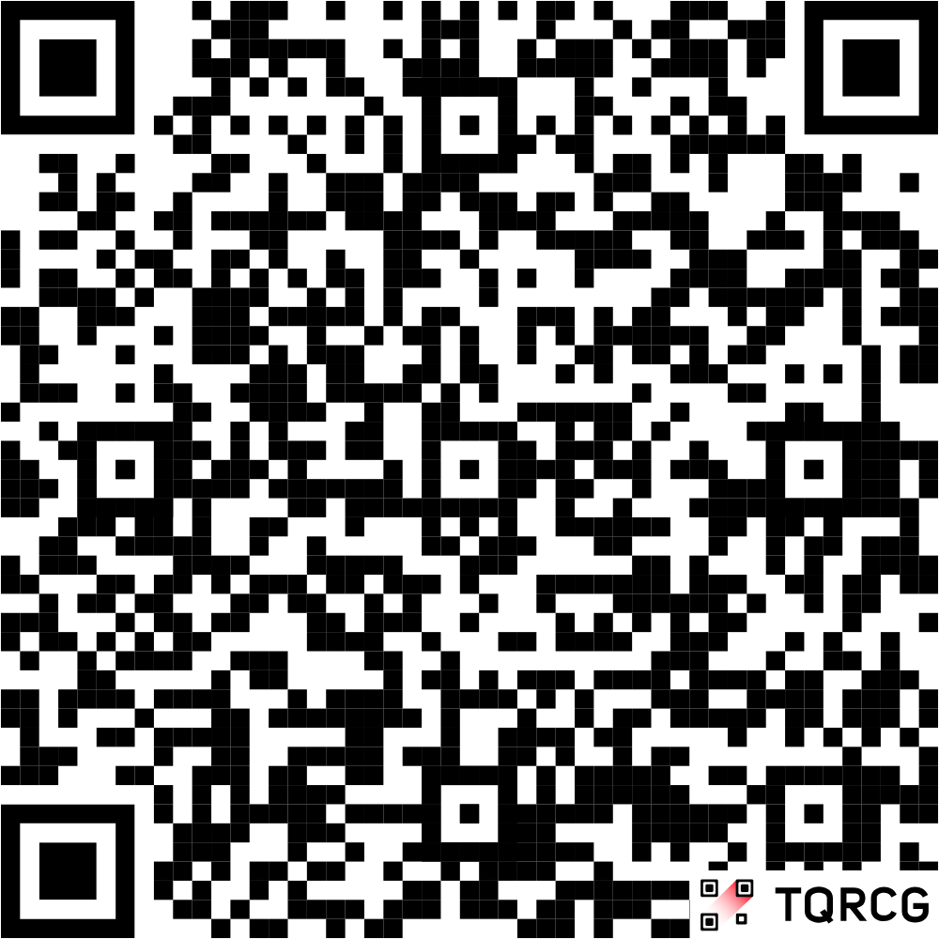
Fitness Through Sport Playbook
The Fitness through Sport Playbook is designed to provide Special Olympics coaches with information and ideas to introduce fitness topics to athletes.
Check out the Fitness Through
Sport website

Slide 106
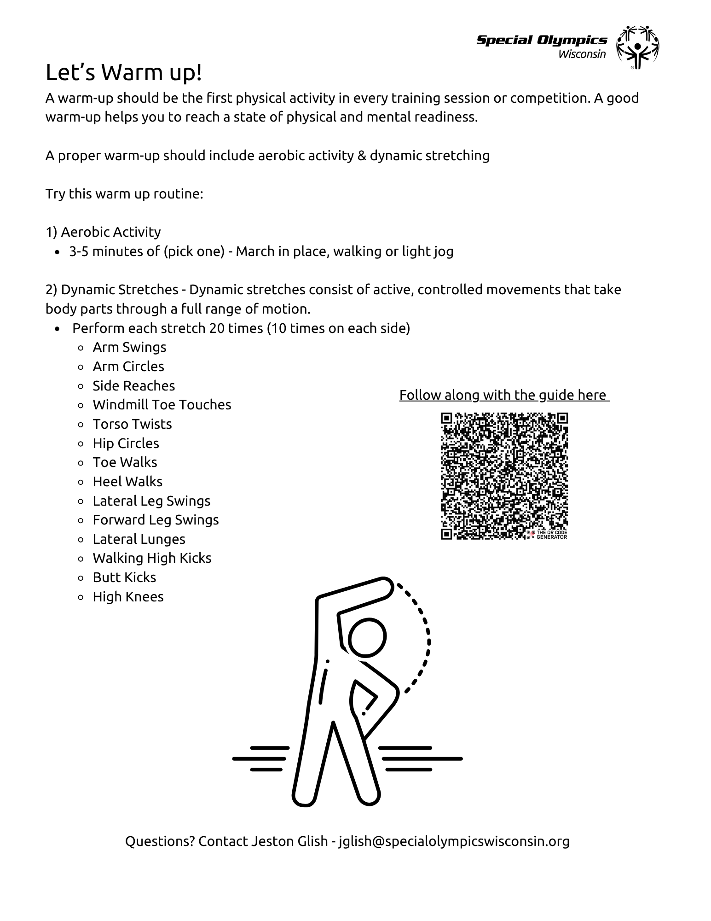

Slide 107
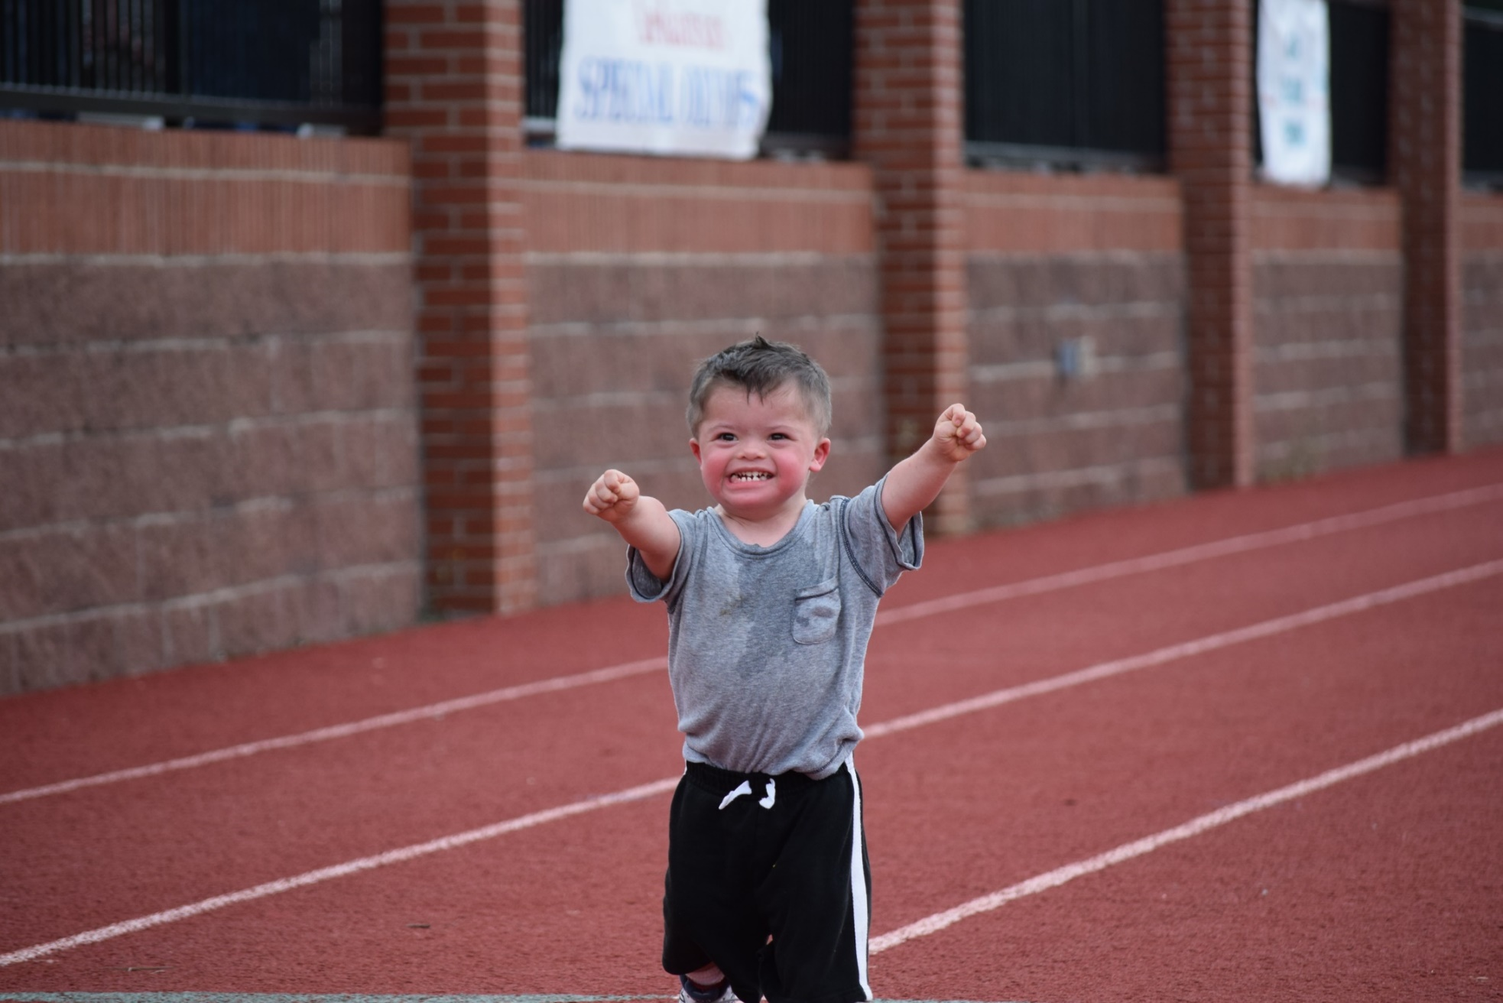
Questions?

Slide 108
Thank you.
Jeston Glish, jglish@specialolympicswisconsin.org

Slide 109
Fall Meeting Wrap-up
Accreditations open until Oct. 31, 2025
  LP Budget
  Succession Plan
LP Guide Updated
  Complete version by section on SOWI Website: Local Program Management - Special Olympics Wisconsin
  Also includes condensed version
    Part of packet
Future Fall Meetings
  None
    Quarterly - Virtual
    Topic driven

Slide 110
Questions???
Form in folder to fill out and leave at the main table
Email your Regional Staff or the Sr. Director of Field Services
If a specific call – refer to the “Who do you call” sheet
FAQs will be put together and uploaded to the SOWI website under Local Program Management section

Slide 111
"Let me win, but if I cannot win, let me be brave in the attempt."
– Athlete Oath

